Slide 1

COURSE SLIDES
Wireshark Network Analysis Masterclass
Course Code: C1123
Conducted by Tertiary Infotech Academy Pte Ltd · UEN 201200696W
Version v5.0 · 5 October 2026
© 2026 Tertiary Infotech Academy Pte Ltd. All rights reserved. · www.tertiarycourses.com.sg

Slide 2
COURSE ADMINISTRATION
Welcome & Housekeeping
Wireshark Network Analysis Masterclass (C1123) · C1123
© 2026 Tertiary Infotech Academy Pte Ltd
1

Slide 3
YOUR TRAINER · GENERAL
About the Trainer
NAME
____________________________________________
?
TITLE / DESIGNATION
____________________________________________
QUALIFICATIONS
____________________________________________
Your Trainer
AREAS OF EXPERTISE
____________________________________________
General Trainer template —
to be completed by the trainer
TRAINING & INDUSTRY EXPERIENCE
____________________________________________
CONTACT
____________________________________________
Wireshark Network Analysis Masterclass (C1123) · C1123
© 2026 Tertiary Infotech Academy Pte Ltd
2

Slide 4
YOUR TRAINER
About the Trainer
ROLE
Principal Trainer, Tertiary Infotech Academy Pte. Ltd.
AA
CERTIFICATION
PhD — specialises in networking, cyber security, cloud and AI.
Dr. Alfred Ang
DELIVERS
Courses on network analysis, cyber security, cloud and AI for Tertiary Infotech Academy.
Principal Trainer
Tertiary Infotech Academy Pte. Ltd.
FOUNDER
Founder and lead instructor at Tertiary Infotech / Tertiary Courses.
Wireshark Network Analysis Masterclass (C1123) · C1123
© 2026 Tertiary Infotech Academy Pte Ltd
3

Slide 5
ICE-BREAKER
Let's Know Each Other
Your name and organisation / role.
1
Your experience with Wireshark or network troubleshooting (if any).
2
A slow or broken network problem you would like to be able to explain with packets.
3
Wireshark Network Analysis Masterclass (C1123) · C1123
© 2026 Tertiary Infotech Academy Pte Ltd
4

Slide 6
HOUSEKEEPING
Ground Rules
Set your mobile phone to silent mode.
Participate actively — no question is too small.
1
2
Mutual respect: agree to disagree.
One conversation at a time.
3
4
Be punctual; return from breaks on time.
Learn by doing — try every hands-on lab.
5
6
Wireshark Network Analysis Masterclass (C1123) · C1123
© 2026 Tertiary Infotech Academy Pte Ltd
5

Slide 7
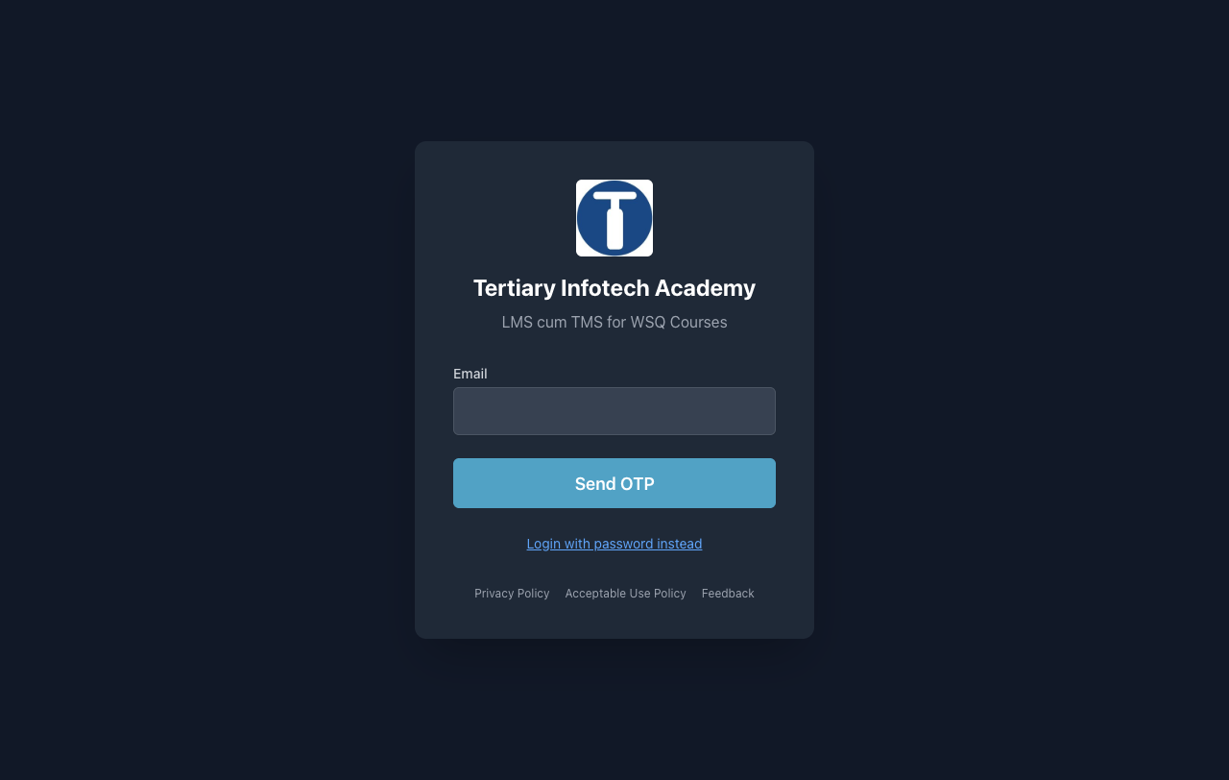
COURSE PORTAL
Download Course Material
• Go to lms-tms.tertiaryinfotech.com.
• Enter your registered email and click Send OTP.
• Key in the one-time password from your inbox to log in.
• Open this course to download the slides, Learner Guide and Lesson Plan.
• Keep them open during class — refer to them as you work through each lab.
https://lms-tms.tertiaryinfotech.com
Wireshark Network Analysis Masterclass (C1123) · C1123
© 2026 Tertiary Infotech Academy Pte Ltd
6

Slide 8
SCHEDULE
Lesson Plan — 4 Days, 8 hours/day (Days 1–2)
Day 1
Day 2
• Day 1 — Capture and analyst workflow
– Topic 1: Introduction to Network Analysis and Wireshark (Lab 1)
– Topic 2: Capture Methods and Capture Filters (Lab 2)
– Topic 3: Global Preferences and Troubleshooting Profiles (Lab 3)
– Topic 4: Navigation and Coloring Techniques (Lab 4)
• Day 2 — Time, statistics, filters and DNS
– Topic 5: Time Values and Delay Types (Lab 5)
– Topic 6: Trace Statistics and VoIP Overview (Lab 6)
– Topic 7: Display Filters (Lab 7)
– Topic 8: TCP/IP Communications and Resolution (Lab 8)
– Topic 9: DNS Traffic Analysis (Lab 9)
Wireshark Network Analysis Masterclass (C1123) · C1123
© 2026 Tertiary Infotech Academy Pte Ltd
7

Slide 9
SCHEDULE
Lesson Plan — 4 Days, 8 hours/day (Days 3–4)
Day 3
Day 4
• Day 3 — IP and transport diagnostics
– Topic 10: ARP Traffic Analysis (Lab 10)
– Topic 11: IPv4 Traffic Analysis (Lab 11)
– Topic 12: ICMP Traffic Analysis (Lab 12)
– Topic 13: UDP Traffic Analysis (Lab 13)
– Topic 14: TCP Protocol Analysis (Lab 14)
• Day 4 — Graphs, applications and reporting
– Topic 15: Traffic Graphs (Lab 15)
– Topic 16: HTTP and HTTP/2 Analysis (Lab 16)
– Topic 17: TLS-Encrypted Traffic Analysis (Lab 17)
– Topic 18: Ten Troubleshooting Steps and Reporting (Lab 18)
• Daily timing
– 9:30am–6:30pm · 1-hour lunch · tea breaks within training time
Wireshark Network Analysis Masterclass (C1123) · C1123
© 2026 Tertiary Infotech Academy Pte Ltd
8

Slide 10
WHAT YOU'LL ACHIEVE
Learning Outcomes
Capture & profile
Plan scoped captures and configure a reproducible analyst profile.
Navigate & time
Navigate, filter, summarize and time network exchanges.
1
2
Core protocols
Interpret DNS, ARP, IPv4, ICMP and UDP evidence.
TCP & applications
Diagnose TCP and application behaviour, including HTTP and authorised TLS inspection.
3
4
Evidence reporting
Report observed facts, hypotheses and next actions with defensible evidence.
5
Wireshark Network Analysis Masterclass (C1123) · C1123
© 2026 Tertiary Infotech Academy Pte Ltd
9

Slide 11
LEARNING APPROACH
How You'll Learn
1
2
3
4
5
▶
▶
▶
▶
Trainer demonstrates the concept
You build it yourself in the hands-on lab
Verify with the lab's 'Test it' step
Discuss and troubleshoot together
Recap against the learning outcomes
Wireshark Network Analysis Masterclass (C1123) · C1123
© 2026 Tertiary Infotech Academy Pte Ltd
10

Slide 12
CORE CONCEPTS
Network Analysis Fundamentals
Wireshark Network Analysis Masterclass (C1123) · C1123
© 2026 Tertiary Infotech Academy Pte Ltd
11

Slide 13
OVERVIEW
What is Wireshark?
Packet analyzer
Captures packets and presents every field it can decode — a measuring device for the network.
Free and open source
Cross-platform (Windows, macOS, Linux) with TShark as its command-line twin.
1
2
3,000+ protocols
Dissectors decode Ethernet to HTTP/2, DNS, TLS, SIP/RTP and more.
Evidence, not opinion
Every claim cites a frame number, a filter and a measurement.
3
4
Wireshark Network Analysis Masterclass (C1123) · C1123
© 2026 Tertiary Infotech Academy Pte Ltd
12

Slide 14
THE BUILDING BLOCKS
Who Uses Wireshark — and Why
Network administrators
Troubleshoot slow and failing connections.
Security analysts
Examine suspicious conversations and indicators.
1
2
QA and developers
Verify and debug protocol implementations.
Support engineers
Prove where a delay or failure actually occurs.
3
4
Learners
See how network protocols really behave on the wire.
Incident responders
Preserve packet evidence for a report.
5
6
Wireshark Network Analysis Masterclass (C1123) · C1123
© 2026 Tertiary Infotech Academy Pte Ltd
13

Slide 15
THE ANALYST MINDSET
Capture the evidence. Explain the uncertainty.
A trace is a measurement at one observation point — this course teaches you to say exactly what it proves and what it does not.
Wireshark Network Analysis Masterclass (C1123) · C1123
© 2026 Tertiary Infotech Academy Pte Ltd
14

Slide 16
COURSE ROADMAP
The Four Days at a Glance
Capture & navigate
Protocols & transport
Applications & reporting
• Place the capture point correctly
• Build a reproducible analyst profile
• Colour, time and filter efficiently
• DNS, ARP, IPv4, ICMP, UDP evidence
• TCP handshake, loss, retransmission
• Zero window and recovery
• I/O, RTT and Stevens graphs
• HTTP outcomes, HTTP/2 and TLS
• An evidence-led incident report
Wireshark Network Analysis Masterclass (C1123) · C1123
© 2026 Tertiary Infotech Academy Pte Ltd
15

Slide 17
THE LEARNING ARC
How Every Lab Progresses
Open the lab's own synthetic capture — no live network traffic is needed.
Apply the lab filter and locate the frames that answer the question.
1
2
Record frame numbers, measurements and one limitation in outputs/findings.md.
Run scripts/verify.py — it confirms the capture facts your findings rely on.
3
4
Wireshark Network Analysis Masterclass (C1123) · C1123
© 2026 Tertiary Infotech Academy Pte Ltd
16

Slide 18
01
TOPIC 01
Introduction to Network Analysis and Wireshark
Establish a trace baseline
Wireshark Network Analysis Masterclass (C1123) · C1123
© 2026 Tertiary Infotech Academy Pte Ltd
17

Slide 19
KEY CONCEPTS
Key Concepts — Introduction to Network Analysis and Wireshark
A capture is a measurement at one observation point, not a complete network history.
Packet list, protocol details and bytes connect a summary to the underlying evidence.
1
2
Record interface, timestamp precision, dropped packets and capture scope before interpreting a trace.
3
Wireshark Network Analysis Masterclass (C1123) · C1123
© 2026 Tertiary Infotech Academy Pte Ltd
18

Slide 20
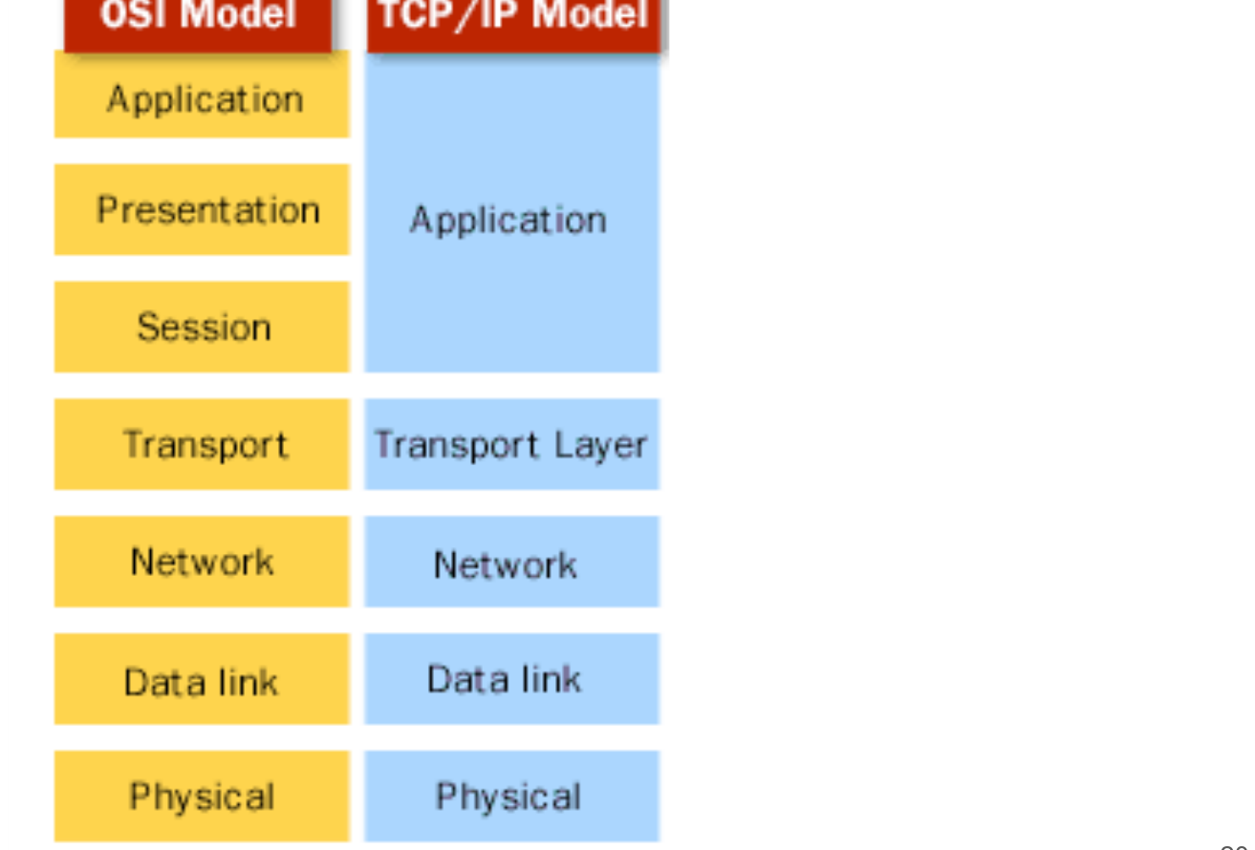
REFRESHER
The TCP/IP and OSI Models
• The OSI model has seven layers; TCP/IP folds them into four.
• Wireshark's Packet Details pane is ordered the same way — frame, Ethernet, IP, TCP/UDP, application.
• Locate each fault at a layer before you choose a filter.
OSI layers mapped to the TCP/IP model
Wireshark Network Analysis Masterclass (C1123) · C1123
© 2026 Tertiary Infotech Academy Pte Ltd
19

Slide 21
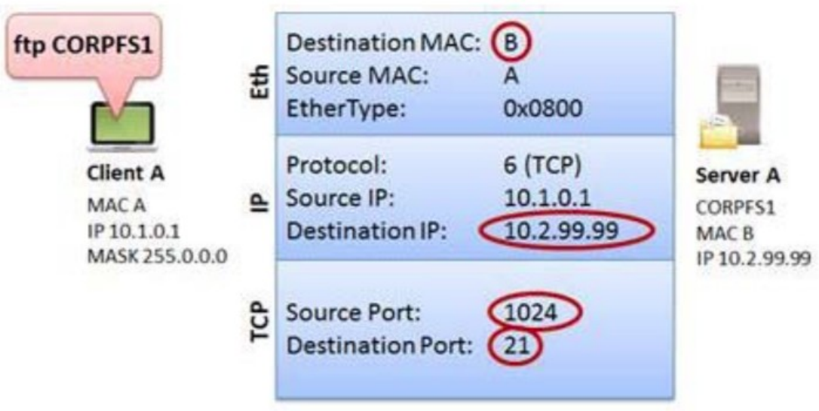
ENCAPSULATION
Building a Packet
• Each layer wraps the one above: an application payload gains TCP, IP and Ethernet headers.
• MAC addresses change at every hop; IP addresses stay end-to-end (unless NAT rewrites them).
• Ports identify the conversation on each host.
Encapsulation of an FTP request from client A to server A
Wireshark Network Analysis Masterclass (C1123) · C1123
© 2026 Tertiary Infotech Academy Pte Ltd
20

Slide 22
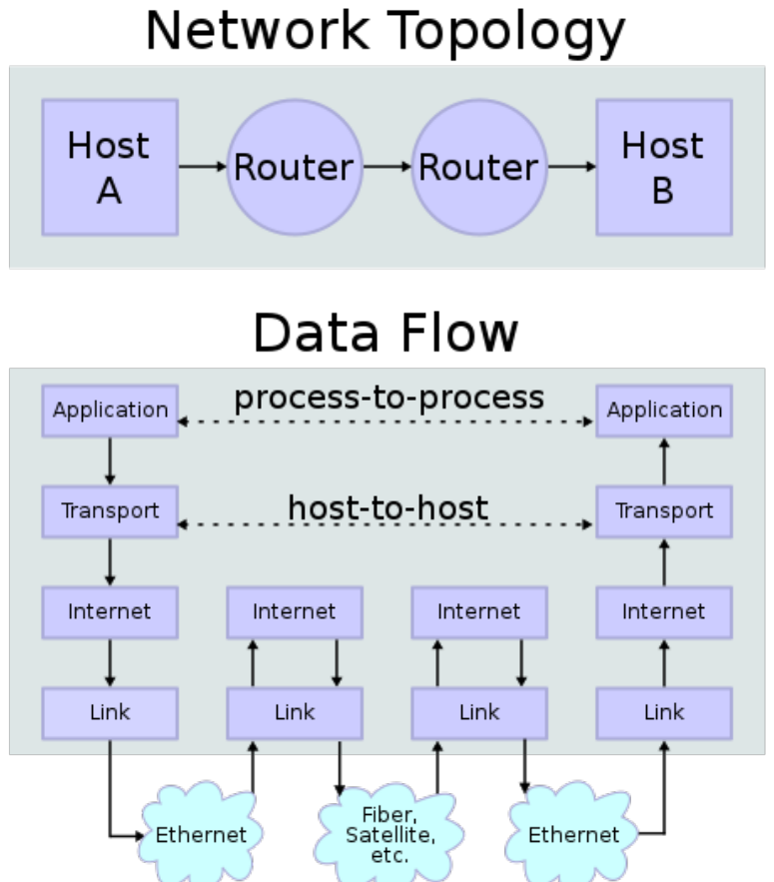
DATA FLOW
Data Flow Through the Network
• Data passes down the sender's stack, across switches and routers, and up the receiver's stack.
• Switches forward on MAC; routers forward on IP.
• Where you capture decides which hops you can see.
Process-to-process, host-to-host and hop-by-hop delivery
Wireshark Network Analysis Masterclass (C1123) · C1123
© 2026 Tertiary Infotech Academy Pte Ltd
21

Slide 23
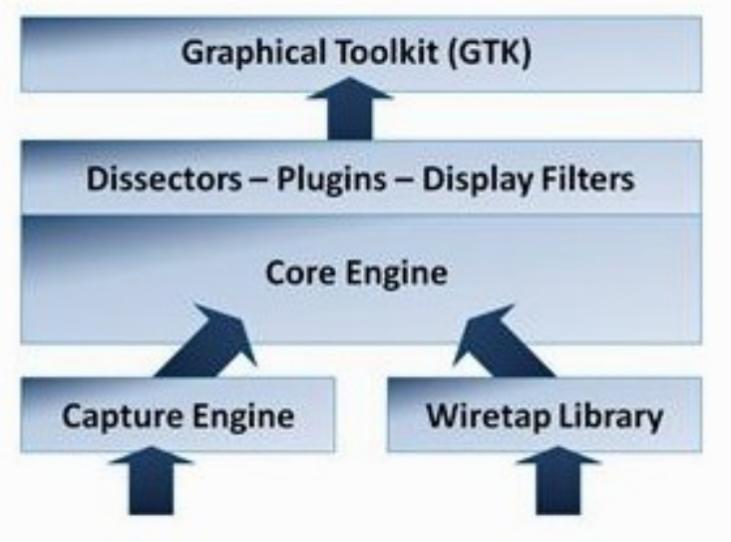
ARCHITECTURE
Inside Wireshark
• The capture engine collects packets through libpcap / Npcap.
• Wiretap reads and writes trace formats: pcap, pcapng, snoop and more.
• Dissectors decode each protocol; display filters operate on the dissected fields.
Packet processing elements (the GUI is Qt-based in current releases)
Wireshark Network Analysis Masterclass (C1123) · C1123
© 2026 Tertiary Infotech Academy Pte Ltd
22

Slide 24
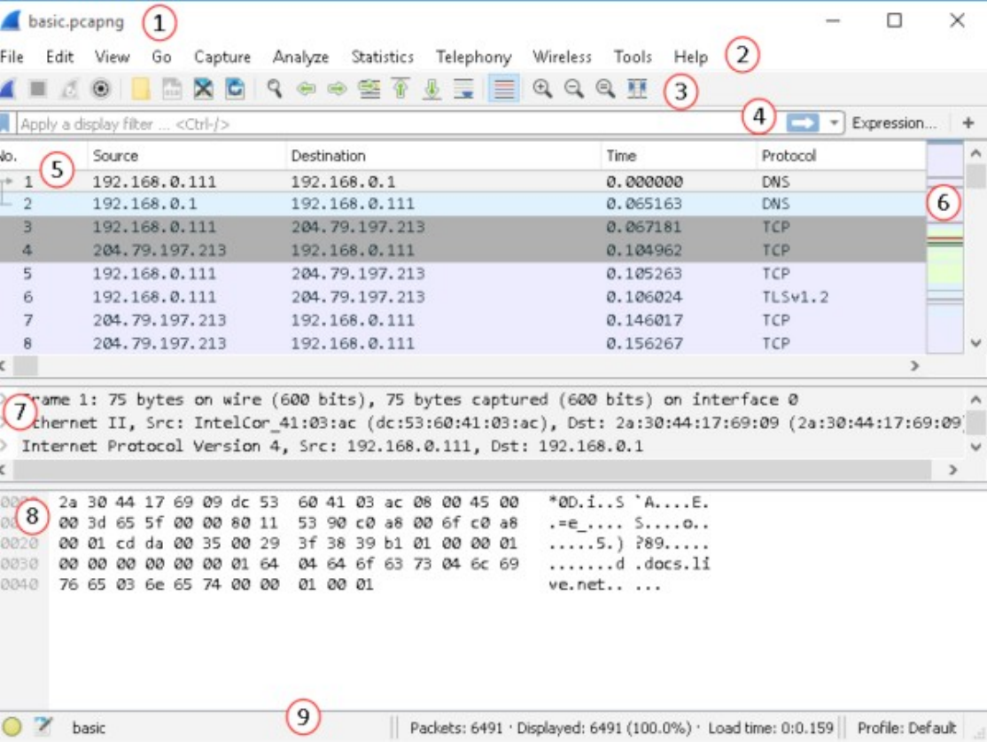
USER INTERFACE
The Wireshark Window
• Packet List — one summary row per frame.
• Packet Details — the decoded protocol tree.
• Packet Bytes — the raw hex for the selected field.
• Status bar — packet counts, profile and file information.
The three main panes plus toolbars and status bar
Wireshark Network Analysis Masterclass (C1123) · C1123
© 2026 Tertiary Infotech Academy Pte Ltd
23

Slide 25
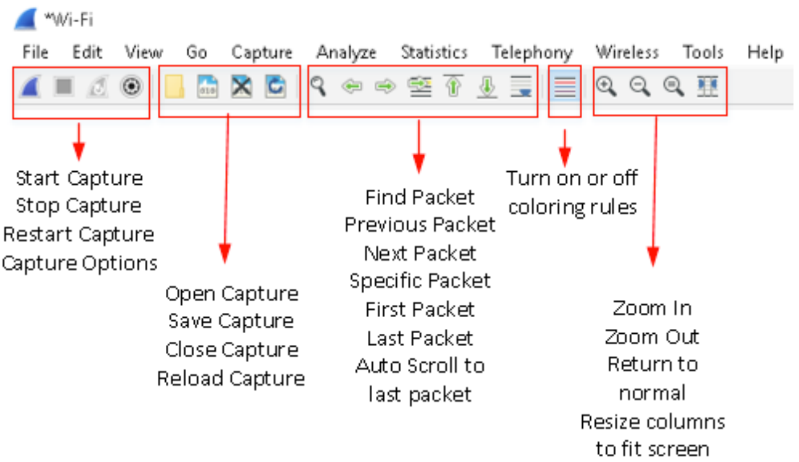
USER INTERFACE
The Main Toolbar
Start/stop capture, open/save, find and go-to packet, colourise and zoom controls
Wireshark Network Analysis Masterclass (C1123) · C1123
© 2026 Tertiary Infotech Academy Pte Ltd
24

Slide 26
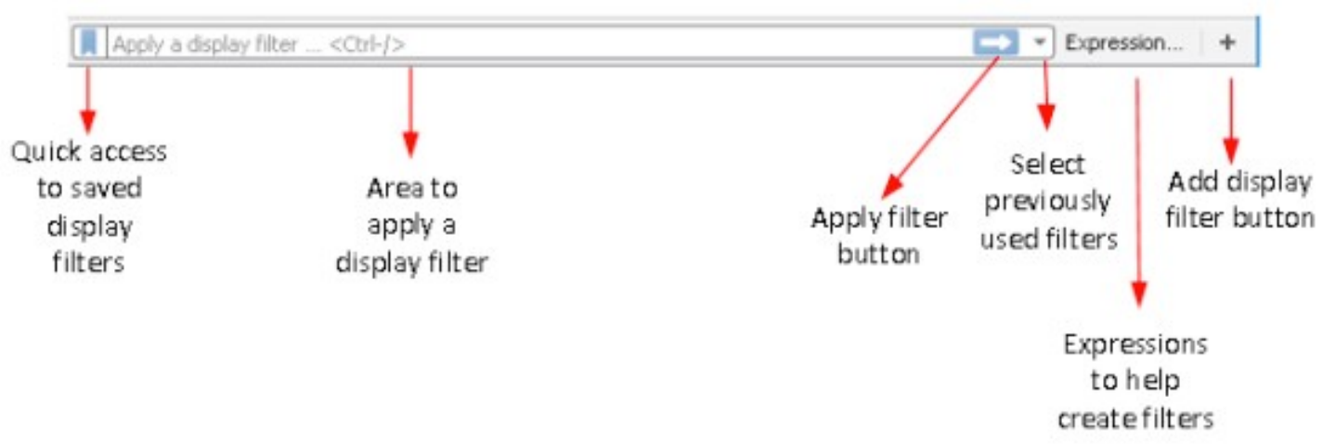
USER INTERFACE
The Display Filter Toolbar
Green = valid expression, red = invalid; bookmark saved filters and add filter buttons
Wireshark Network Analysis Masterclass (C1123) · C1123
© 2026 Tertiary Infotech Academy Pte Ltd
25

Slide 27
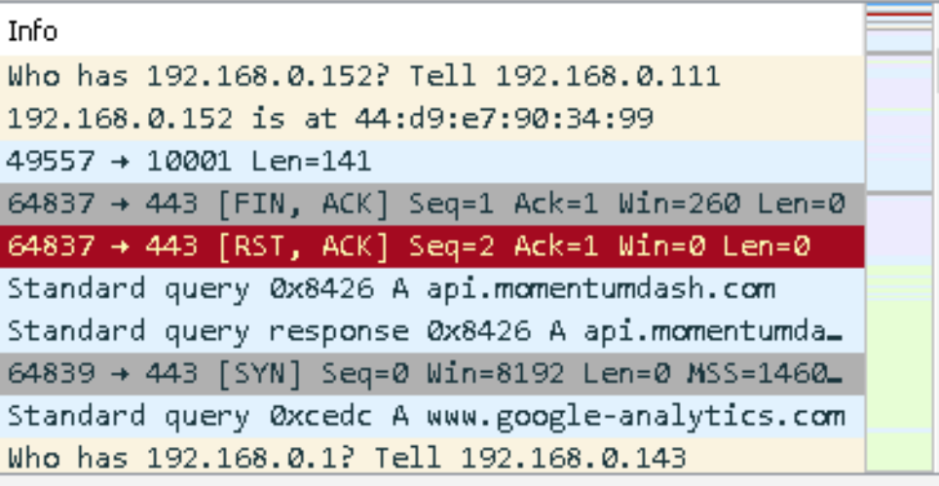
USER INTERFACE
Status Bar and Intelligent Scrollbar
• The status bar shows packets captured vs. displayed and the active profile.
• The intelligent scrollbar mirrors packet colouring — red/black bands reveal resets, aborts or low-TTL packets at a glance.
Coloured scrollbar bands mark problem packets
Wireshark Network Analysis Masterclass (C1123) · C1123
© 2026 Tertiary Infotech Academy Pte Ltd
26

Slide 28
TOPIC 01 · HANDS-ON
Establish a trace baseline
LAB 1
A capture is a measurement at one observation point, not a complete network history.
You'll build
Evidence CSV and packet findings
Tools: Wireshark, TShark, Python
Wireshark Network Analysis Masterclass (C1123) · C1123
© 2026 Tertiary Infotech Academy Pte Ltd
27

Slide 29
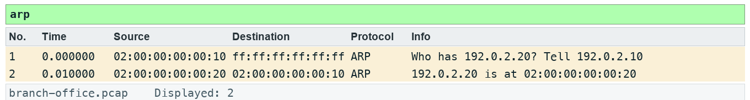
LAB 1 · EXPECTED EVIDENCE
Expected Evidence — Lab 1
Produced by TShark 4.6 from this lab's own synthetic capture with the lab filter(s) applied — your packet list should match.
Wireshark Network Analysis Masterclass (C1123) · C1123
© 2026 Tertiary Infotech Academy Pte Ltd
28

Slide 30
LAB 1
Establish a trace baseline
STEP 1 OF 5
Prepare your lab workspace. Open this lab folder in a terminal. Windows uses py -3 in place of python3. Wireshark GUI alone is sufficient for the investigation; CLI scripts require TShark on PATH. Run the fixture verification first.
1
$ python3 scripts/verify.py
Wireshark Network Analysis Masterclass (C1123) · C1123
© 2026 Tertiary Infotech Academy Pte Ltd
29

Slide 31
LAB 1
Establish a trace baseline
STEP 2 OF 5
Open data/branch-office.pcap with File > Open. Clear the display filter. Record the packet count from the status bar and the capture duration from Statistics > Capture File Properties.
2
Wireshark Network Analysis Masterclass (C1123) · C1123
© 2026 Tertiary Infotech Academy Pte Ltd
30

Slide 32
LAB 1
Establish a trace baseline
STEP 3 OF 5
Select frame 1. Expand Ethernet II and Address Resolution Protocol in Packet Details. Click the sender IP field and observe the corresponding bytes.
3
Wireshark Network Analysis Masterclass (C1123) · C1123
© 2026 Tertiary Infotech Academy Pte Ltd
31

Slide 33
LAB 1
Establish a trace baseline
STEP 4 OF 5
Apply arp in the display filter toolbar. Compare request and reply sender/target IP and MAC addresses. Save the two frame numbers in outputs/findings.md.
4
Wireshark Network Analysis Masterclass (C1123) · C1123
© 2026 Tertiary Infotech Academy Pte Ltd
32

Slide 34
LAB 1
Establish a trace baseline
STEP 5 OF 5
Export a reproducible packet table. Record the filter, frame numbers, measurement, explanation and limitation in outputs/findings.md.
5
$ python3 scripts/export_evidence.py
Wireshark Network Analysis Masterclass (C1123) · C1123
© 2026 Tertiary Infotech Academy Pte Ltd
33

Slide 35
LAB 1 · VERIFY
Establish a trace baseline
✅ Test it
The supplied arp expression matches 2 frame(s) in the specified capture. Run scripts/verify.py and compare the listed frame numbers. Keep your findings and exported table in outputs/. Explain the observed result rather than only copying a count.
Wireshark Network Analysis Masterclass (C1123) · C1123
© 2026 Tertiary Infotech Academy Pte Ltd
34

Slide 36
TOPIC RECAP
Recap — Introduction to Network Analysis and Wireshark
You can now: plan scoped captures and configure a reproducible analyst profile.
A capture is a measurement at one observation point, not a complete network history.
1
2
Packet list, protocol details and bytes connect a summary to the underlying evidence.
Record interface, timestamp precision, dropped packets and capture scope before interpreting a trace.
3
4
Wireshark Network Analysis Masterclass (C1123) · C1123
© 2026 Tertiary Infotech Academy Pte Ltd
35

Slide 37
Tea Break
15 minutes

Slide 38
02
TOPIC 02
Capture Methods and Capture Filters
Plan capture placement
Wireshark Network Analysis Masterclass (C1123) · C1123
© 2026 Tertiary Infotech Academy Pte Ltd
37

Slide 39
KEY CONCEPTS
Key Concepts — Capture Methods and Capture Filters
A switched access port normally observes its own traffic and broadcasts; SPAN or TAP placement changes visibility.
Capture filters use libpcap syntax before packets are stored; display filters hide or show stored packets.
1
2
Bound file size and duration; check capture drops before attributing missing packets to network loss.
3
Wireshark Network Analysis Masterclass (C1123) · C1123
© 2026 Tertiary Infotech Academy Pte Ltd
38

Slide 40
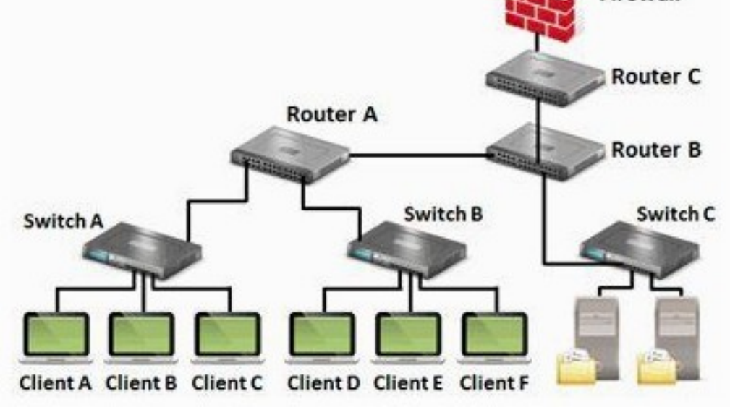
CAPTURE PLACEMENT
Where to Tap Into the Network
• Client A complains about reaching the servers — where do you put the analyzer?
• Capture as close as possible to the complaining host first, then move toward the servers.
• Each point sees only the traffic that physically passes it.
Choose the observation point before you capture
Wireshark Network Analysis Masterclass (C1123) · C1123
© 2026 Tertiary Infotech Academy Pte Ltd
39

Slide 41
SWITCHED NETWORKS
What a Switch Port Can See
Switch port (default)
Ways to see more
• Broadcast traffic
• Multicast traffic (if forwarded)
• Traffic to and from your own host
• Not other hosts' unicast traffic
• Hub in half-duplex segment (lab only)
• Network TAP — passive, in-line
• SPAN / port mirroring on the switch
• Capture on the target host itself
Wireshark Network Analysis Masterclass (C1123) · C1123
© 2026 Tertiary Infotech Academy Pte Ltd
40

Slide 42
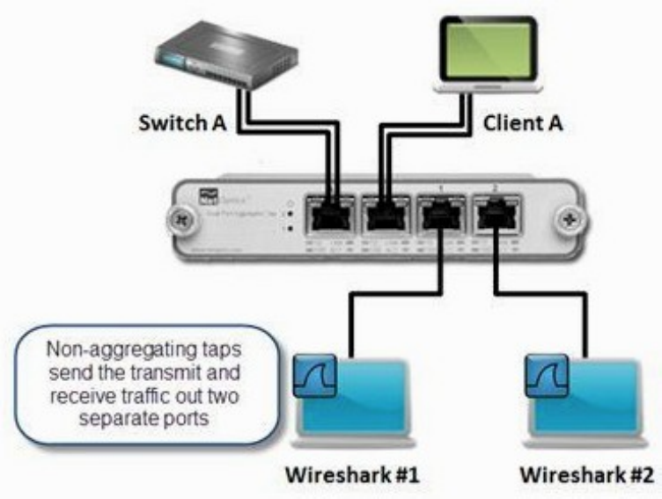
TAPS
Test Access Points (TAPs)
• A TAP sits in-line and passively copies traffic to the analyzer.
• Full-duplex TAPs forward both directions — and can pass physical-layer errors.
• Aggregating TAPs merge both directions onto one monitor port.
A non-aggregating TAP with two monitor ports
Wireshark Network Analysis Masterclass (C1123) · C1123
© 2026 Tertiary Infotech Academy Pte Ltd
41

Slide 43
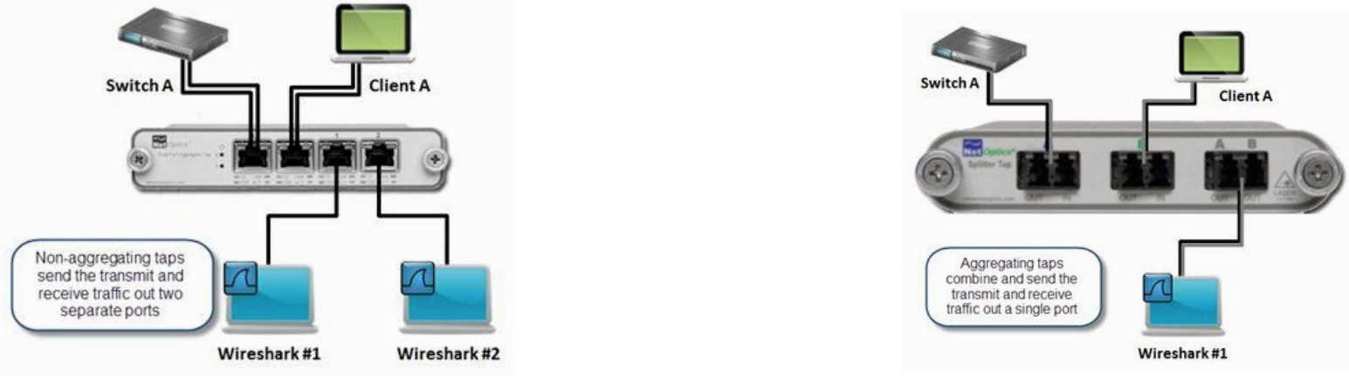
TAPS
Aggregating vs Non-aggregating TAPs
Non-aggregating: one port per direction. Aggregating: both directions combined on one port — can oversubscribe at high load
Wireshark Network Analysis Masterclass (C1123) · C1123
© 2026 Tertiary Infotech Academy Pte Ltd
42

Slide 44
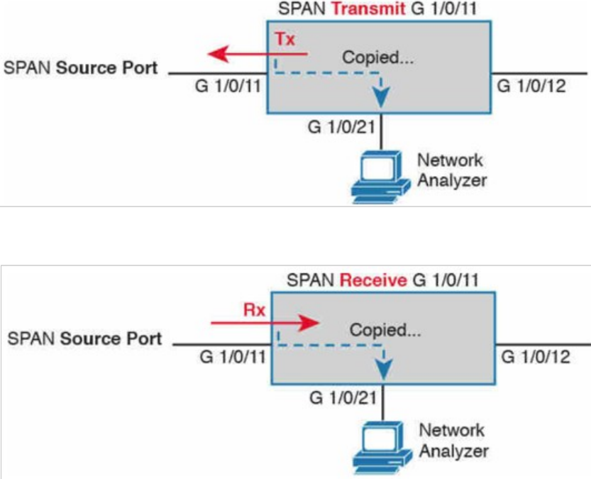
SPAN
SPAN / Port Mirroring
• The switch copies traffic from source ports or VLANs to a destination port.
• Mirrored traffic can drop under load and normally excludes errored frames.
• Example (Cisco): monitor session 1 source interface g1/0/11 both.
SPAN copies transmitted and received frames to the analyzer port
Wireshark Network Analysis Masterclass (C1123) · C1123
© 2026 Tertiary Infotech Academy Pte Ltd
43

Slide 45
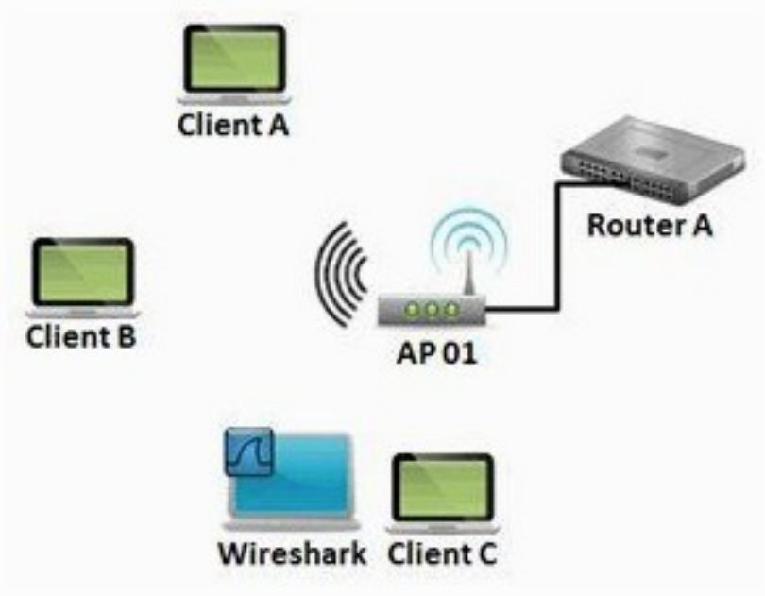
WIRELESS
Wireless Capture
• Promiscuous mode on Wi-Fi usually shows only your own traffic.
• Monitor mode captures 802.11 frames from all stations on a channel — needs a supporting adapter/driver.
• Decrypting WPA2 traffic requires the passphrase and the 4-way handshake.
Wireless capture depends on the adapter mode
Wireshark Network Analysis Masterclass (C1123) · C1123
© 2026 Tertiary Infotech Academy Pte Ltd
44

Slide 46
FILTERING
Capture Filters vs Display Filters
Capture filter (BPF)
Display filter
• Applied before packets are stored
• Syntax: host 10.1.1.5 and tcp port 80
• Discarded packets cannot be recovered
• Use to limit file size on busy links
• Applied to packets already captured
• Syntax: ip.addr == 10.1.1.5 && tcp.port == 80
• Clear it to see everything again
• Use for analysis and evidence
Wireshark Network Analysis Masterclass (C1123) · C1123
© 2026 Tertiary Infotech Academy Pte Ltd
45

Slide 47
TOPIC 02 · HANDS-ON
Plan capture placement
LAB 2
A switched access port normally observes its own traffic and broadcasts; SPAN or TAP placement changes visibility.
You'll build
Evidence CSV and packet findings
Tools: Wireshark, TShark, Python
Wireshark Network Analysis Masterclass (C1123) · C1123
© 2026 Tertiary Infotech Academy Pte Ltd
46

Slide 48
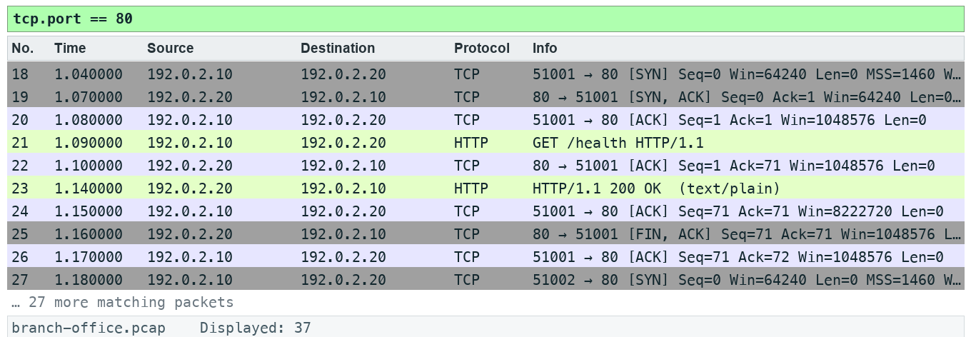
LAB 2 · EXPECTED EVIDENCE
Expected Evidence — Lab 2
Produced by TShark 4.6 from this lab's own synthetic capture with the lab filter(s) applied — your packet list should match.
Wireshark Network Analysis Masterclass (C1123) · C1123
© 2026 Tertiary Infotech Academy Pte Ltd
47

Slide 49
LAB 2
Plan capture placement
STEP 1 OF 6
Prepare your lab workspace. Open this lab folder in a terminal. Windows uses py -3 in place of python3. Wireshark GUI alone is sufficient for the investigation; CLI scripts require TShark on PATH. Run the fixture verification first.
1
$ python3 scripts/verify.py
Wireshark Network Analysis Masterclass (C1123) · C1123
© 2026 Tertiary Infotech Academy Pte Ltd
48

Slide 50
LAB 2
Plan capture placement
STEP 2 OF 6
Open assets/topology.md. Draw a sensor on the client access port, on a mirrored uplink and beside the server. State which traffic each sees.
2
Wireshark Network Analysis Masterclass (C1123) · C1123
© 2026 Tertiary Infotech Academy Pte Ltd
49

Slide 51
LAB 2
Plan capture placement
STEP 3 OF 6
Open Capture > Options and inspect the interface list without starting a capture. Enter tcp port 80 in the capture-filter box and check syntax feedback. Cancel the dialog.
3
Wireshark Network Analysis Masterclass (C1123) · C1123
© 2026 Tertiary Infotech Academy Pte Ltd
50

Slide 52
LAB 2
Plan capture placement
STEP 4 OF 6
Open data/branch-office.pcap. Enter tcp.port == 80 in the DISPLAY toolbar. Compare the stored total with the displayed total; explain why clearing it restores hidden packets.
4
Wireshark Network Analysis Masterclass (C1123) · C1123
© 2026 Tertiary Infotech Academy Pte Ltd
51

Slide 53
LAB 2
Plan capture placement
STEP 5 OF 6
Complete assets/capture-plan.md with scope, interface, duration, ring-buffer limit and permission owner. Wireless monitor mode requires compatible adapter/driver; USB capture requires platform-specific support. Remote capture should use authorised SSH/extcap, not obsolete unauthenticated RPC instructions.
5
Wireshark Network Analysis Masterclass (C1123) · C1123
© 2026 Tertiary Infotech Academy Pte Ltd
52

Slide 54
LAB 2
Plan capture placement
STEP 6 OF 6
Export a reproducible packet table. Record the filter, frame numbers, measurement, explanation and limitation in outputs/findings.md.
6
$ python3 scripts/export_evidence.py
Wireshark Network Analysis Masterclass (C1123) · C1123
© 2026 Tertiary Infotech Academy Pte Ltd
53

Slide 55
LAB 2 · VERIFY
Plan capture placement
✅ Test it
The supplied tcp.port == 80 expression matches 37 frame(s) in the specified capture. Run scripts/verify.py and compare the listed frame numbers. Keep your findings and exported table in outputs/. Explain the observed result rather than only copying a count.
Wireshark Network Analysis Masterclass (C1123) · C1123
© 2026 Tertiary Infotech Academy Pte Ltd
54

Slide 56
TOPIC RECAP
Recap — Capture Methods and Capture Filters
You can now: plan scoped captures and configure a reproducible analyst profile.
A switched access port normally observes its own traffic and broadcasts; SPAN or TAP placement changes visibility.
1
2
Capture filters use libpcap syntax before packets are stored; display filters hide or show stored packets.
Bound file size and duration; check capture drops before attributing missing packets to network loss.
3
4
Wireshark Network Analysis Masterclass (C1123) · C1123
© 2026 Tertiary Infotech Academy Pte Ltd
55

Slide 57
Lunch Break
1 hour

Slide 58
03
TOPIC 03
Global Preferences and Troubleshooting Profiles
Create an analyst profile
Wireshark Network Analysis Masterclass (C1123) · C1123
© 2026 Tertiary Infotech Academy Pte Ltd
57

Slide 59
KEY CONCEPTS
Key Concepts — Global Preferences and Troubleshooting Profiles
A profile bundles reproducible columns, coloring rules and protocol settings.
Name resolution can obscure numeric evidence and generate additional traffic; document the setting.
1
2
Protocol heuristics and TCP analysis preferences change interpretation, not the stored bytes.
3
Wireshark Network Analysis Masterclass (C1123) · C1123
© 2026 Tertiary Infotech Academy Pte Ltd
58

Slide 60
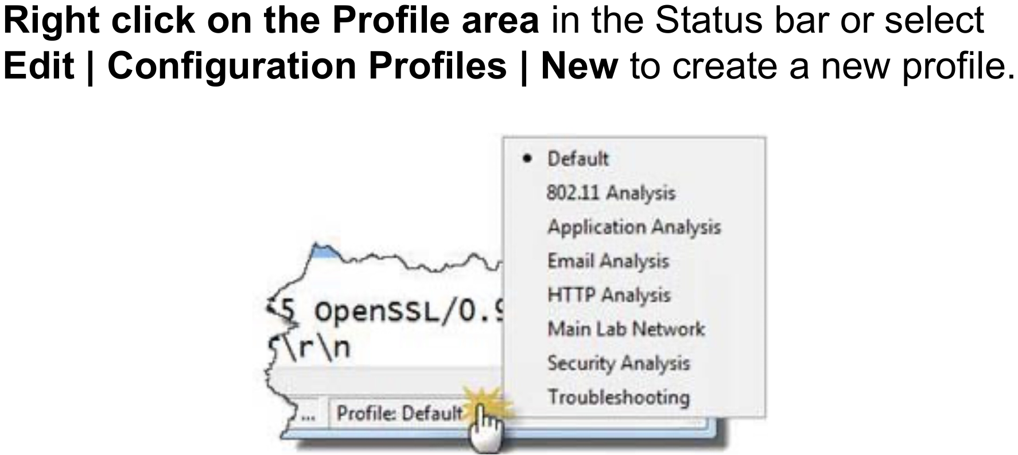
PROFILES
Configuration Profiles
• A profile bundles preferences, columns, colouring rules and filter buttons.
• Switch profiles from the status bar or Edit > Configuration Profiles.
• Create task profiles: Troubleshooting, Security, VoIP, Wireless.
Right-click the Profile area in the status bar to switch or create
Wireshark Network Analysis Masterclass (C1123) · C1123
© 2026 Tertiary Infotech Academy Pte Ltd
59

Slide 61
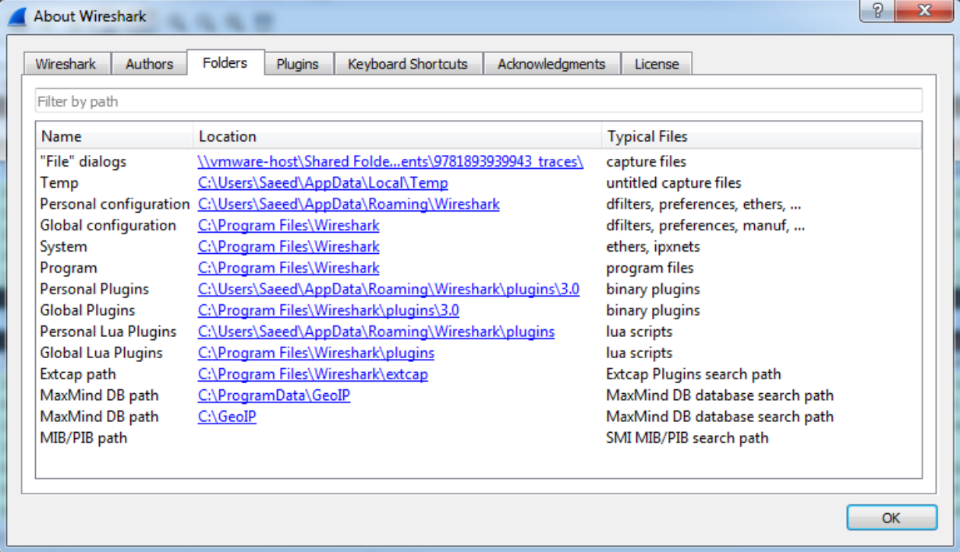
CONFIGURATION
Where Settings Live
• Help > About Wireshark > Folders shows personal and global configuration paths.
• Copy a profile folder to share it with your team.
• Keep a clean Default profile untouched.
The Folders tab lists personal configuration locations
Wireshark Network Analysis Masterclass (C1123) · C1123
© 2026 Tertiary Infotech Academy Pte Ltd
60

Slide 62
PREFERENCES
Preferences That Change Interpretation
Name resolution
Columns
Protocol settings
• Off by default for evidence
• MAC/transport names are local look-ups
• Network names cause extra DNS traffic
• Add fields as columns (Apply as Column)
• e.g. tcp.time_delta, http.host
• Save them in the profile
• TCP: calculate conversation timestamps
• TCP: relative sequence numbers
• TLS: key log file per lab
Wireshark Network Analysis Masterclass (C1123) · C1123
© 2026 Tertiary Infotech Academy Pte Ltd
61

Slide 63
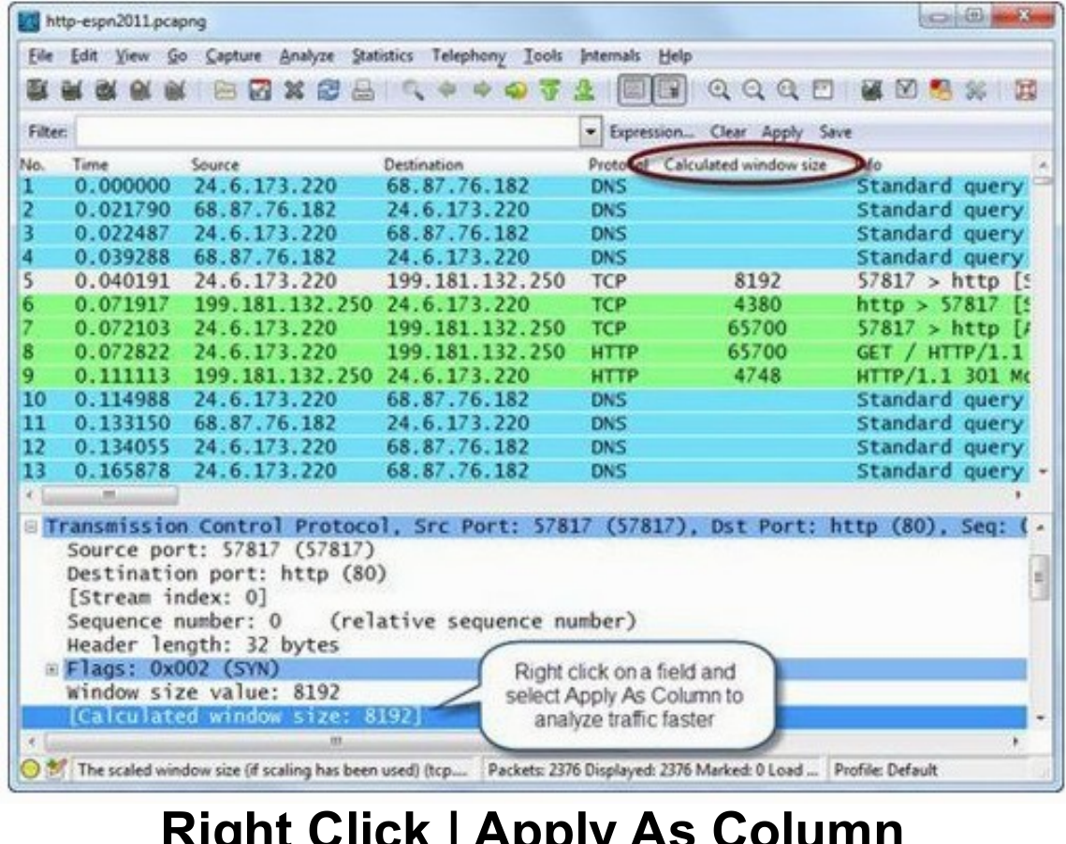
PRODUCTIVITY
Apply as Column
• Right-click any field in Packet Details > Apply as Column.
• Sort the new column to find extremes — largest delay, largest window, error codes.
• Columns are saved in the active profile.
Right-click | Apply As Column
Wireshark Network Analysis Masterclass (C1123) · C1123
© 2026 Tertiary Infotech Academy Pte Ltd
62

Slide 64
TOPIC 03 · HANDS-ON
Create an analyst profile
LAB 3
A profile bundles reproducible columns, coloring rules and protocol settings.
You'll build
Evidence CSV and packet findings
Tools: Wireshark, TShark, Python
Wireshark Network Analysis Masterclass (C1123) · C1123
© 2026 Tertiary Infotech Academy Pte Ltd
63

Slide 65
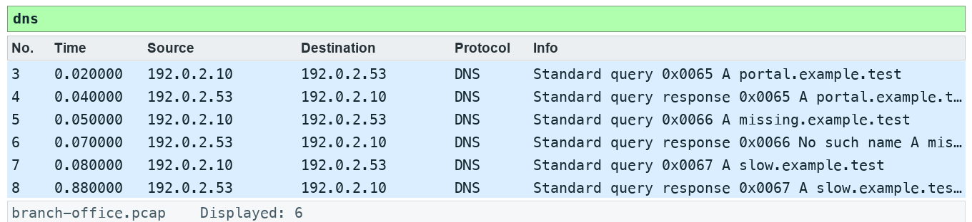
LAB 3 · EXPECTED EVIDENCE
Expected Evidence — Lab 3
Produced by TShark 4.6 from this lab's own synthetic capture with the lab filter(s) applied — your packet list should match.
Wireshark Network Analysis Masterclass (C1123) · C1123
© 2026 Tertiary Infotech Academy Pte Ltd
64

Slide 66
LAB 3
Create an analyst profile
STEP 1 OF 6
Prepare your lab workspace. Open this lab folder in a terminal. Windows uses py -3 in place of python3. Wireshark GUI alone is sufficient for the investigation; CLI scripts require TShark on PATH. Run the fixture verification first.
1
$ python3 scripts/verify.py
Wireshark Network Analysis Masterclass (C1123) · C1123
© 2026 Tertiary Infotech Academy Pte Ltd
65

Slide 67
LAB 3
Create an analyst profile
STEP 2 OF 6
Create a profile named C1123-Analyst using Edit > Configuration Profiles. Keep the original profile available.
2
Wireshark Network Analysis Masterclass (C1123) · C1123
© 2026 Tertiary Infotech Academy Pte Ltd
66

Slide 68
LAB 3
Create an analyst profile
STEP 3 OF 6
Open data/branch-office.pcap. Disable network name resolution in View > Name Resolution. Record numeric client, server and resolver IP addresses.
3
Wireshark Network Analysis Masterclass (C1123) · C1123
© 2026 Tertiary Infotech Academy Pte Ltd
67

Slide 69
LAB 3
Create an analyst profile
STEP 4 OF 6
Select a TCP packet. Expand TCP and right-click Stream index > Apply as Column. Add frame.time_delta_displayed as a custom column using Preferences > Appearance > Columns.
4
Wireshark Network Analysis Masterclass (C1123) · C1123
© 2026 Tertiary Infotech Academy Pte Ltd
68

Slide 70
LAB 3
Create an analyst profile
STEP 5 OF 6
Apply dns and inspect the profile name and displayed columns. Copy the profile folder path from Help > About Wireshark > Folders into outputs/findings.md. Export or copy your profile to outputs/profile/ without overwriting a colleague profile.
5
Wireshark Network Analysis Masterclass (C1123) · C1123
© 2026 Tertiary Infotech Academy Pte Ltd
69

Slide 71
LAB 3
Create an analyst profile
STEP 6 OF 6
Export a reproducible packet table. Record the filter, frame numbers, measurement, explanation and limitation in outputs/findings.md.
6
$ python3 scripts/export_evidence.py
Wireshark Network Analysis Masterclass (C1123) · C1123
© 2026 Tertiary Infotech Academy Pte Ltd
70

Slide 72
LAB 3 · VERIFY
Create an analyst profile
✅ Test it
The supplied dns expression matches 6 frame(s) in the specified capture. Run scripts/verify.py and compare the listed frame numbers. Keep your findings and exported table in outputs/. Explain the observed result rather than only copying a count.
Wireshark Network Analysis Masterclass (C1123) · C1123
© 2026 Tertiary Infotech Academy Pte Ltd
71

Slide 73
TOPIC RECAP
Recap — Global Preferences and Troubleshooting Profiles
You can now: plan scoped captures and configure a reproducible analyst profile.
A profile bundles reproducible columns, coloring rules and protocol settings.
1
2
Name resolution can obscure numeric evidence and generate additional traffic; document the setting.
Protocol heuristics and TCP analysis preferences change interpretation, not the stored bytes.
3
4
Wireshark Network Analysis Masterclass (C1123) · C1123
© 2026 Tertiary Infotech Academy Pte Ltd
72

Slide 74
Tea Break
15 minutes

Slide 75
04
TOPIC 04
Navigation and Coloring Techniques
Color and annotate evidence
Wireshark Network Analysis Masterclass (C1123) · C1123
© 2026 Tertiary Infotech Academy Pte Ltd
74

Slide 76
KEY CONCEPTS
Key Concepts — Navigation and Coloring Techniques
Color rules are applied in order; the first matching rule wins.
Temporary coloring is useful for a conversation; permanent rules support repeated triage.
1
2
Bookmarks and comments preserve the analyst path without changing the captured payload.
3
Wireshark Network Analysis Masterclass (C1123) · C1123
© 2026 Tertiary Infotech Academy Pte Ltd
75

Slide 77
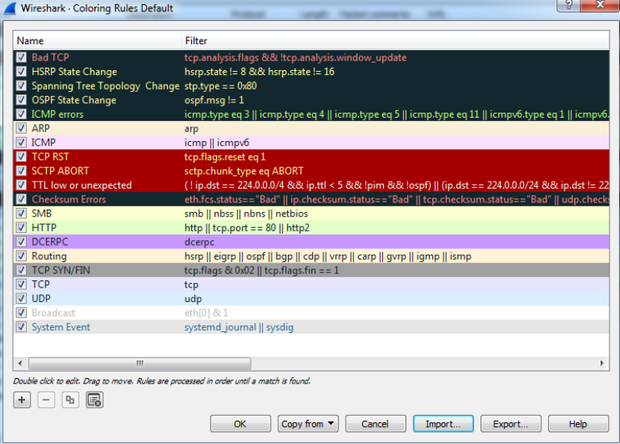
COLOURING
Colouring Rules
• Rules are evaluated top-down — the first match colours the packet.
• Default rules flag Bad TCP, HTTP, DNS, ARP, ICMP errors and more.
• View > Coloring Rules to edit, import or export a rule set.
The coloring rules list is processed in order
Wireshark Network Analysis Masterclass (C1123) · C1123
© 2026 Tertiary Infotech Academy Pte Ltd
76

Slide 78
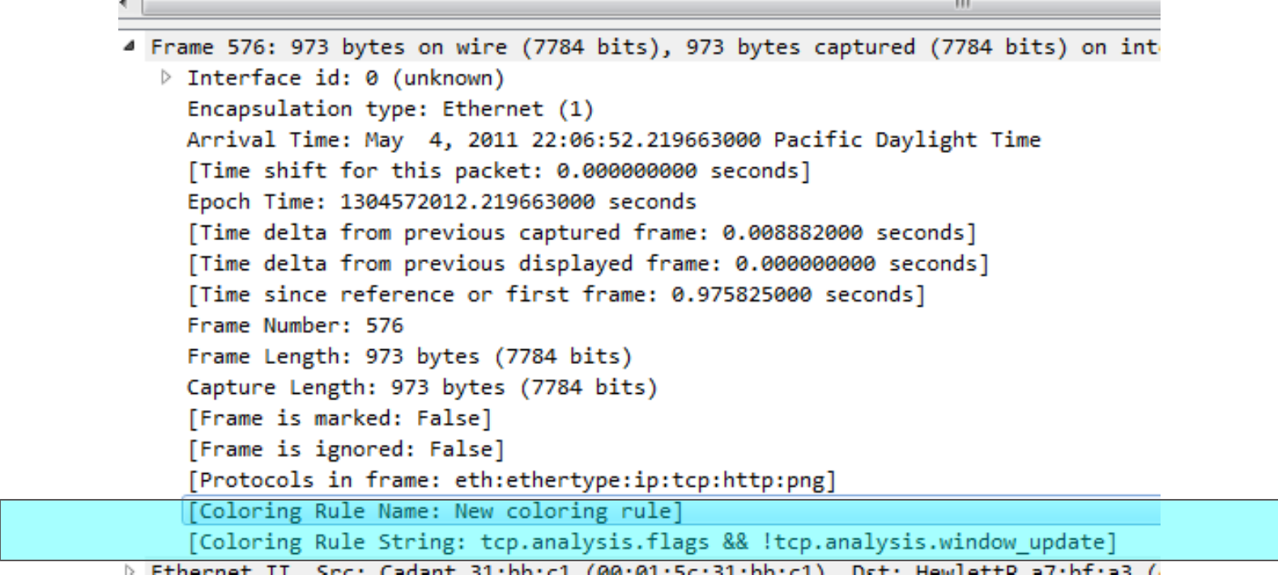
COLOURING
Why Is a Packet This Colour?
• Expand the Frame section of Packet Details.
• Coloring Rule Name and Coloring Rule String show which rule matched.
• Use this to explain colours in a report.
Frame > Coloring Rule Name / String
Wireshark Network Analysis Masterclass (C1123) · C1123
© 2026 Tertiary Infotech Academy Pte Ltd
77

Slide 79
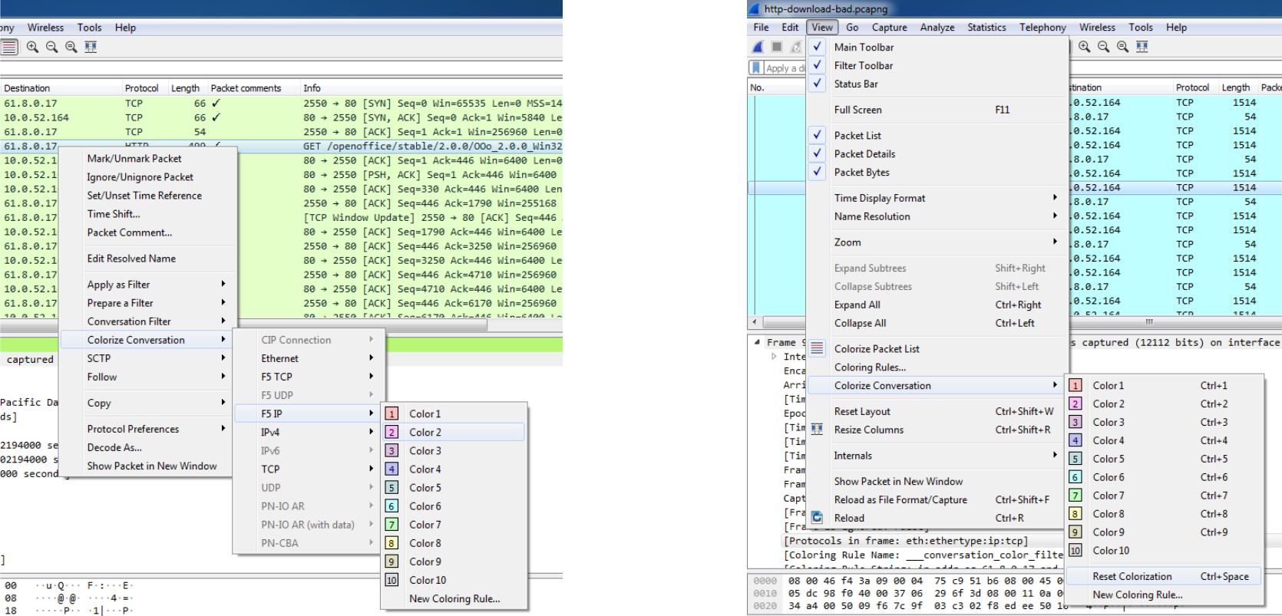
COLOURING
Colourise a Conversation
• Right-click a packet > Colorize Conversation to tag a TCP/UDP stream temporarily.
• Ten temporary colours make parallel conversations easy to tell apart.
• View > Colorize Conversation > Reset to clear.
Temporary conversation colouring
Wireshark Network Analysis Masterclass (C1123) · C1123
© 2026 Tertiary Infotech Academy Pte Ltd
78

Slide 80
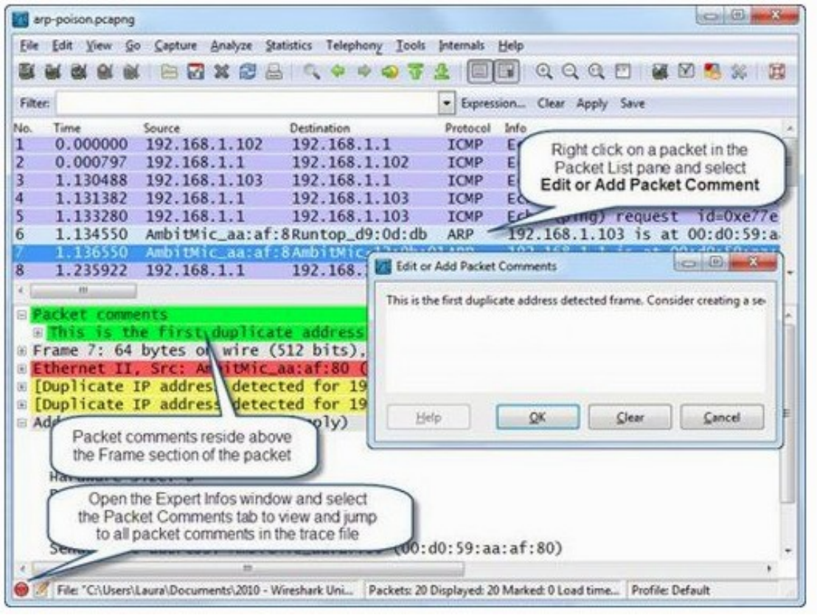
ANNOTATION
Marking and Annotating Packets
• Mark (Ctrl+M) for quick navigation — marks are lost when the file closes.
• Packet comments are saved in pcapng and travel with the evidence.
• Time Shift corrects clock offsets between captures.
Right-click | Packet Comment
Wireshark Network Analysis Masterclass (C1123) · C1123
© 2026 Tertiary Infotech Academy Pte Ltd
79

Slide 81
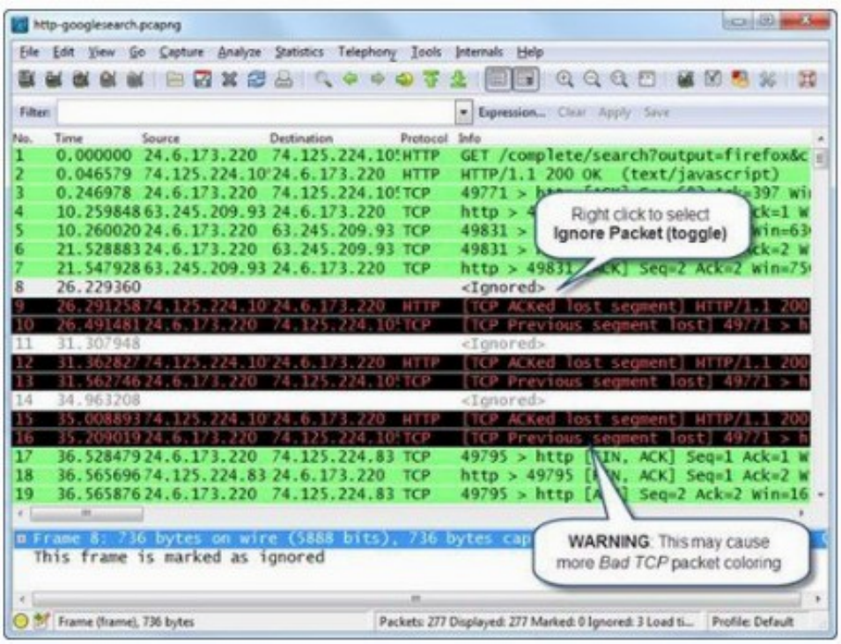
NAVIGATION
Navigation Shortcuts
• Ctrl+G — go to packet number.
• Ctrl+F — find by display filter, hex or string.
• Ctrl+. / Ctrl+, — next/previous packet in the conversation.
• Ctrl+Space — collapse/expand the Packet Details tree.
Edit | Mark / Ignore packets
Wireshark Network Analysis Masterclass (C1123) · C1123
© 2026 Tertiary Infotech Academy Pte Ltd
80

Slide 82
TOPIC 04 · HANDS-ON
Color and annotate evidence
LAB 4
Color rules are applied in order; the first matching rule wins.
You'll build
Evidence CSV and packet findings
Tools: Wireshark, TShark, Python
Wireshark Network Analysis Masterclass (C1123) · C1123
© 2026 Tertiary Infotech Academy Pte Ltd
81

Slide 83
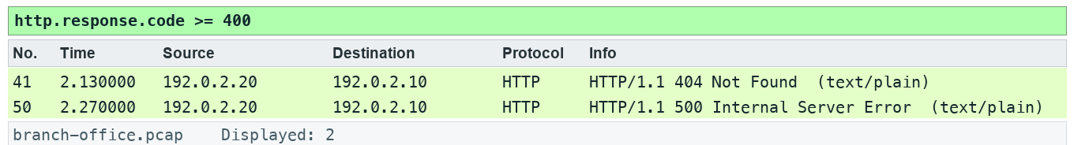
LAB 4 · EXPECTED EVIDENCE
Expected Evidence — Lab 4
Produced by TShark 4.6 from this lab's own synthetic capture with the lab filter(s) applied — your packet list should match.
Wireshark Network Analysis Masterclass (C1123) · C1123
© 2026 Tertiary Infotech Academy Pte Ltd
82

Slide 84
LAB 4
Color and annotate evidence
STEP 1 OF 6
Prepare your lab workspace. Open this lab folder in a terminal. Windows uses py -3 in place of python3. Wireshark GUI alone is sufficient for the investigation; CLI scripts require TShark on PATH. Run the fixture verification first.
1
$ python3 scripts/verify.py
Wireshark Network Analysis Masterclass (C1123) · C1123
© 2026 Tertiary Infotech Academy Pte Ltd
83

Slide 85
LAB 4
Color and annotate evidence
STEP 2 OF 6
Open data/branch-office.pcap. Apply http.response.code >= 400. Record the 404 and 500 frame numbers.
2
Wireshark Network Analysis Masterclass (C1123) · C1123
© 2026 Tertiary Infotech Academy Pte Ltd
84

Slide 86
LAB 4
Color and annotate evidence
STEP 3 OF 6
Open View > Coloring Rules. Add LAB HTTP Error with expression http.response.code >= 400, dark text and a pale amber background. Move it above a general HTTP rule.
3
Wireshark Network Analysis Masterclass (C1123) · C1123
© 2026 Tertiary Infotech Academy Pte Ltd
85

Slide 87
LAB 4
Color and annotate evidence
STEP 4 OF 6
Select the 500 response, mark it using Edit > Mark/Unmark Packet and add a packet comment describing the observed status only. Save As outputs/annotated.pcapng to preserve comments.
4
Wireshark Network Analysis Masterclass (C1123) · C1123
© 2026 Tertiary Infotech Academy Pte Ltd
86

Slide 88
LAB 4
Color and annotate evidence
STEP 5 OF 6
Clear the filter. Use Edit > Find Packet with Display filter http.response.code == 500. Reopen the saved pcapng and confirm the comment persists.
5
Wireshark Network Analysis Masterclass (C1123) · C1123
© 2026 Tertiary Infotech Academy Pte Ltd
87

Slide 89
LAB 4
Color and annotate evidence
STEP 6 OF 6
Export a reproducible packet table. Record the filter, frame numbers, measurement, explanation and limitation in outputs/findings.md.
6
$ python3 scripts/export_evidence.py
Wireshark Network Analysis Masterclass (C1123) · C1123
© 2026 Tertiary Infotech Academy Pte Ltd
88

Slide 90
LAB 4 · VERIFY
Color and annotate evidence
✅ Test it
The supplied http.response.code >= 400 expression matches 2 frame(s) in the specified capture. Run scripts/verify.py and compare the listed frame numbers. Keep your findings and exported table in outputs/. Explain the observed result rather than only copying a count.
Wireshark Network Analysis Masterclass (C1123) · C1123
© 2026 Tertiary Infotech Academy Pte Ltd
89

Slide 91
TOPIC RECAP
Recap — Navigation and Coloring Techniques
You can now: plan scoped captures and configure a reproducible analyst profile.
Color rules are applied in order; the first matching rule wins.
1
2
Temporary coloring is useful for a conversation; permanent rules support repeated triage.
Bookmarks and comments preserve the analyst path without changing the captured payload.
3
4
Wireshark Network Analysis Masterclass (C1123) · C1123
© 2026 Tertiary Infotech Academy Pte Ltd
90

Slide 92
End of Day 1
See you tomorrow

Slide 93
D2
DAY 2
Time, statistics, filters and DNS
Recap of the previous day, then today's topics and labs
Wireshark Network Analysis Masterclass (C1123) · C1123
© 2026 Tertiary Infotech Academy Pte Ltd
92

Slide 94
05
TOPIC 05
Time Values and Delay Types
Separate path and server delay
Wireshark Network Analysis Masterclass (C1123) · C1123
© 2026 Tertiary Infotech Academy Pte Ltd
93

Slide 95
KEY CONCEPTS
Key Concepts — Time Values and Delay Types
Displayed delta depends on the current filter; capture delta does not.
SYN to SYN/ACK gives an initial path-related sample; request to response includes application processing.
1
2
One-sided timestamps cannot identify exactly which intermediate device delayed or dropped a packet.
3
Wireshark Network Analysis Masterclass (C1123) · C1123
© 2026 Tertiary Infotech Academy Pte Ltd
94

Slide 96
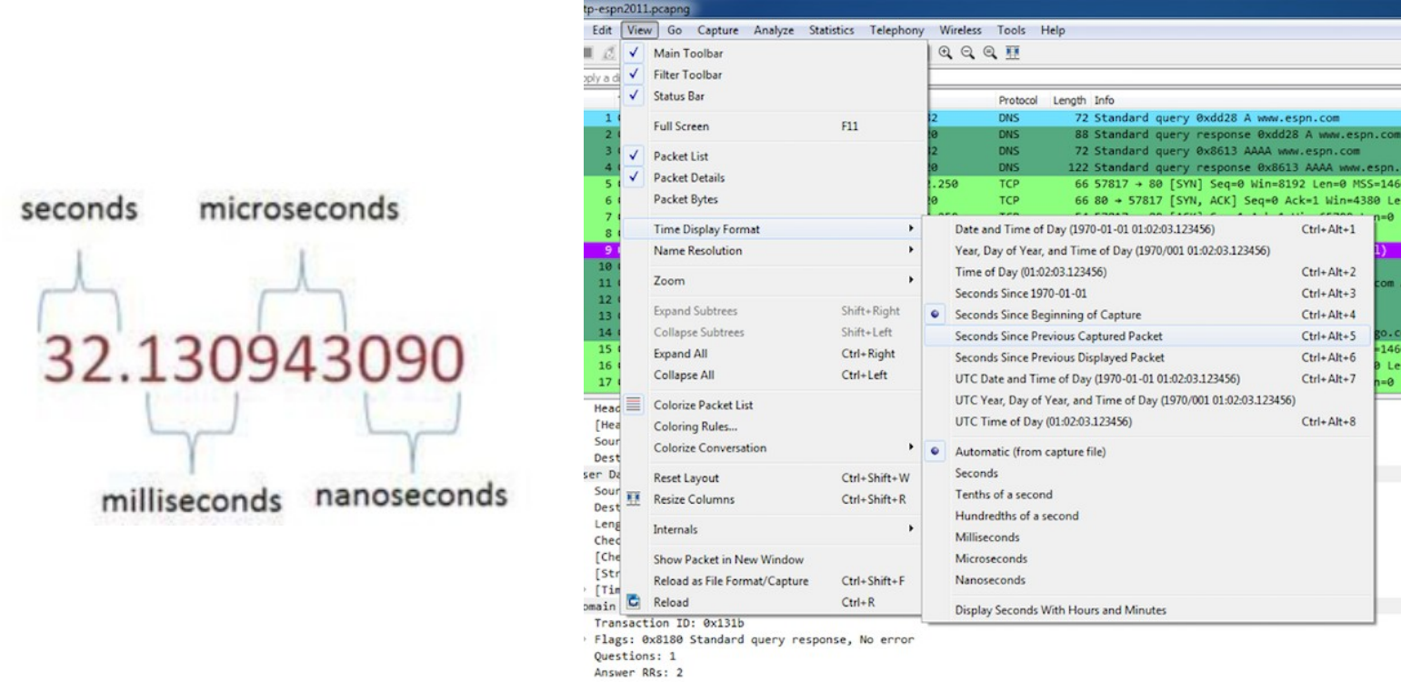
TIME VALUES
Time Display Formats
• View > Time Display Format chooses absolute, relative or delta time.
• Seconds Since Beginning of Capture — default overview.
• Seconds Since Previous Displayed Packet — finds gaps in a filtered view.
Precision depends on the capture hardware and file format
Wireshark Network Analysis Masterclass (C1123) · C1123
© 2026 Tertiary Infotech Academy Pte Ltd
95

Slide 97
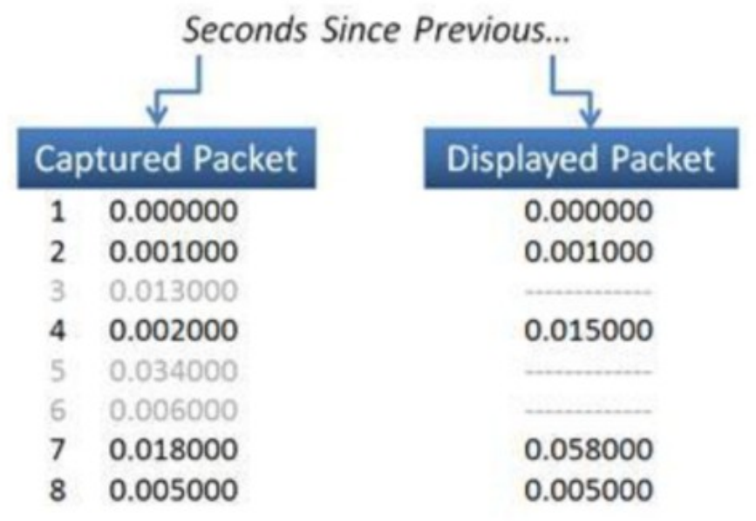
TIME VALUES
Captured vs Displayed Delta
• Delta since previous CAPTURED packet ignores the filter.
• Delta since previous DISPLAYED packet changes when you change the filter.
• State which delta you used in every finding.
Same packets — different deltas
Wireshark Network Analysis Masterclass (C1123) · C1123
© 2026 Tertiary Infotech Academy Pte Ltd
96

Slide 98
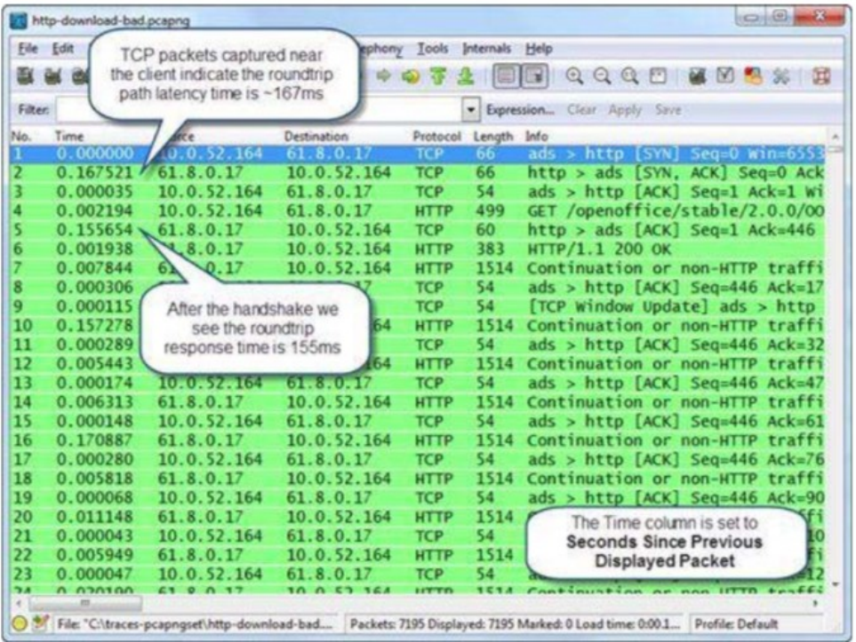
DELAY TYPES
End-to-End Path Delay
• SYN → SYN/ACK gives the initial round-trip time (iRTT) near the client.
• Request → response adds server processing time.
• Large gaps after an ACK point to the server, not the path.
Sort a delta-time column to find the largest gaps
Wireshark Network Analysis Masterclass (C1123) · C1123
© 2026 Tertiary Infotech Academy Pte Ltd
97

Slide 99
DIAGNOSIS
Three Kinds of Delay
Path delay
Server delay
Client delay
• SYN → SYN/ACK (iRTT)
• tcp.analysis.ack_rtt
• Affects every exchange
• ACK → first response byte
• http.time for HTTP
• Grows with server load
• Response → next request
• Think time or app processing
• Often not a network problem
Wireshark Network Analysis Masterclass (C1123) · C1123
© 2026 Tertiary Infotech Academy Pte Ltd
98

Slide 100
TOOLS
Time Reference and Timestamps
Ctrl+T sets a time reference — times are then measured from that packet.
Use a reference per conversation to time one transaction in isolation.
1
2
Timestamp precision is set by the capture system; you cannot add precision later.
Clock offsets between capture points need Time Shift before comparing.
3
4
Wireshark Network Analysis Masterclass (C1123) · C1123
© 2026 Tertiary Infotech Academy Pte Ltd
99

Slide 101
TOPIC 05 · HANDS-ON
Separate path and server delay
LAB 5
Displayed delta depends on the current filter; capture delta does not.
You'll build
Evidence CSV and packet findings
Tools: Wireshark, TShark, Python
Wireshark Network Analysis Masterclass (C1123) · C1123
© 2026 Tertiary Infotech Academy Pte Ltd
100

Slide 102
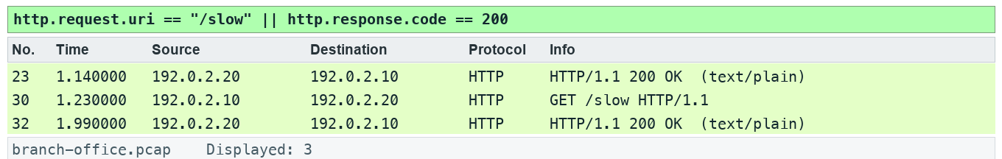
LAB 5 · EXPECTED EVIDENCE
Expected Evidence — Lab 5
Produced by TShark 4.6 from this lab's own synthetic capture with the lab filter(s) applied — your packet list should match.
Wireshark Network Analysis Masterclass (C1123) · C1123
© 2026 Tertiary Infotech Academy Pte Ltd
101

Slide 103
LAB 5
Separate path and server delay
STEP 1 OF 6
Prepare your lab workspace. Open this lab folder in a terminal. Windows uses py -3 in place of python3. Wireshark GUI alone is sufficient for the investigation; CLI scripts require TShark on PATH. Run the fixture verification first.
1
$ python3 scripts/verify.py
Wireshark Network Analysis Masterclass (C1123) · C1123
© 2026 Tertiary Infotech Academy Pte Ltd
102

Slide 104
LAB 5
Separate path and server delay
STEP 2 OF 6
Open data/branch-office.pcap. Apply tcp.stream == 1. Expand TCP in the final handshake ACK and inspect tcp.analysis.initial_rtt: 0.040 seconds. Separately measure SYN to SYN/ACK by setting a time reference on the SYN: 0.030 seconds.
2
Wireshark Network Analysis Masterclass (C1123) · C1123
© 2026 Tertiary Infotech Academy Pte Ltd
103

Slide 105
LAB 5
Separate path and server delay
STEP 3 OF 6
Locate GET /slow and its HTTP response. Set a new time reference on the request. Record the response delta: 0.760 seconds, including 0.010 seconds to the server ACK and 0.750 seconds thereafter.
3
Wireshark Network Analysis Masterclass (C1123) · C1123
© 2026 Tertiary Infotech Academy Pte Ltd
104

Slide 106
LAB 5
Separate path and server delay
STEP 4 OF 6
Apply http.request.uri == "/slow" || http.response.code == 200 and compare frame.time_delta with frame.time_delta_displayed on the filtered list. Explain why a displayed gap can span hidden packets.
4
Wireshark Network Analysis Masterclass (C1123) · C1123
© 2026 Tertiary Infotech Academy Pte Ltd
105

Slide 107
LAB 5
Separate path and server delay
STEP 5 OF 6
Write a hypothesis in outputs/findings.md: slow response with a synthetic 30 ms SYN-to-SYN/ACK interval and 40 ms complete handshake. Name a second observation point required to distinguish processing from a later path delay.
5
Wireshark Network Analysis Masterclass (C1123) · C1123
© 2026 Tertiary Infotech Academy Pte Ltd
106

Slide 108
LAB 5
Separate path and server delay
STEP 6 OF 6
Export a reproducible packet table. Record the filter, frame numbers, measurement, explanation and limitation in outputs/findings.md.
6
$ python3 scripts/export_evidence.py
Wireshark Network Analysis Masterclass (C1123) · C1123
© 2026 Tertiary Infotech Academy Pte Ltd
107

Slide 109
LAB 5 · VERIFY
Separate path and server delay
✅ Test it
The supplied http.request.uri == "/slow" || http.response.code == 200 expression matches 3 frame(s) in the specified capture. Run scripts/verify.py and compare the listed frame numbers. Keep your findings and exported table in outputs/. Explain the observed result rather than only copying a count.
Wireshark Network Analysis Masterclass (C1123) · C1123
© 2026 Tertiary Infotech Academy Pte Ltd
108

Slide 110
TOPIC RECAP
Recap — Time Values and Delay Types
You can now: navigate, filter, summarize and time network exchanges.
Displayed delta depends on the current filter; capture delta does not.
1
2
SYN to SYN/ACK gives an initial path-related sample; request to response includes application processing.
One-sided timestamps cannot identify exactly which intermediate device delayed or dropped a packet.
3
4
Wireshark Network Analysis Masterclass (C1123) · C1123
© 2026 Tertiary Infotech Academy Pte Ltd
109

Slide 111
Tea Break
15 minutes

Slide 112
06
TOPIC 06
Trace Statistics and VoIP Overview
Summarize traffic and a voice stream
Wireshark Network Analysis Masterclass (C1123) · C1123
© 2026 Tertiary Infotech Academy Pte Ltd
111

Slide 113
KEY CONCEPTS
Key Concepts — Trace Statistics and VoIP Overview
Protocol Hierarchy shows captured composition; byte share differs from packet share.
Conversations and Endpoints identify concentration; they do not alone prove malicious activity.
1
2
SIP signals a call while RTP carries media; jitter, loss and codec interpretation need stream context.
3
Wireshark Network Analysis Masterclass (C1123) · C1123
© 2026 Tertiary Infotech Academy Pte Ltd
112

Slide 114
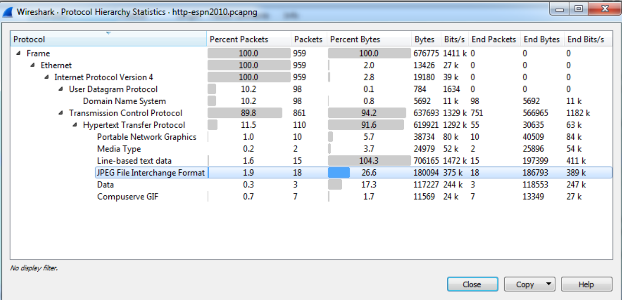
TRACE STATISTICS
Capture File Properties
• Statistics > Capture File Properties: file, time span, interface and drop counts.
• Check packets dropped before blaming the network for loss.
• Record these facts at the start of every analysis.
Statistics | Protocol Hierarchy shows the protocol mix
Wireshark Network Analysis Masterclass (C1123) · C1123
© 2026 Tertiary Infotech Academy Pte Ltd
113

Slide 115
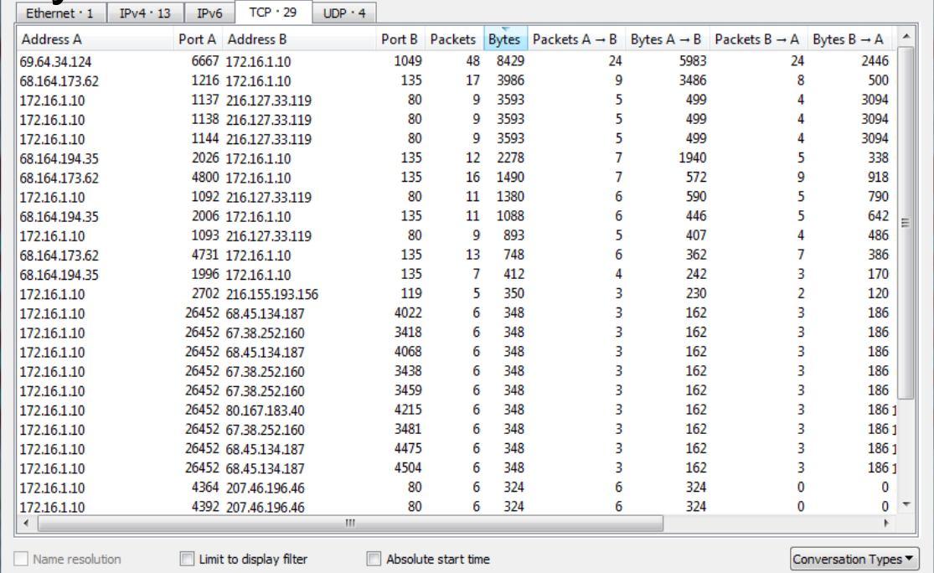
TRACE STATISTICS
Conversations and Endpoints
• Statistics > Conversations lists pairs at Ethernet, IPv4/6, TCP and UDP level.
• Sort by Bytes to find the most active conversation.
• Right-click a row to filter on it.
Statistics | Conversations — TCP tab, sorted by bytes
Wireshark Network Analysis Masterclass (C1123) · C1123
© 2026 Tertiary Infotech Academy Pte Ltd
114

Slide 116
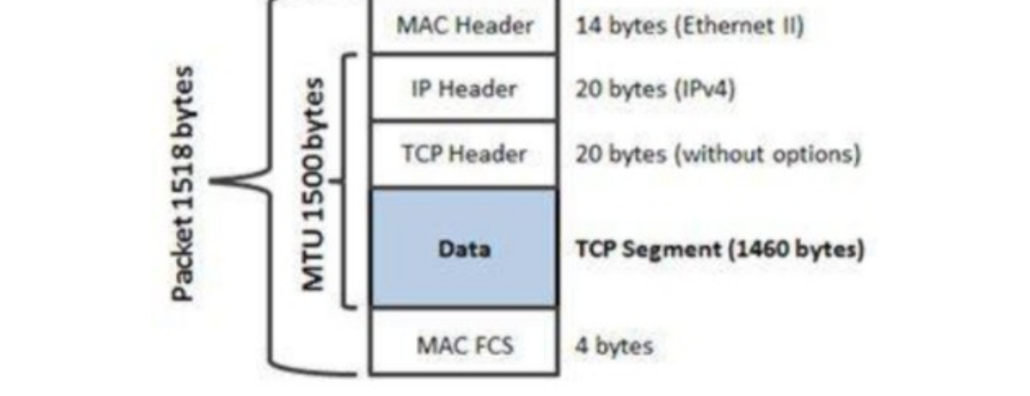
TRACE STATISTICS
Packet Lengths
• Statistics > Packet Lengths shows the size distribution.
• Many tiny packets moving bulk data suggest inefficient application behaviour.
• A full-size Ethernet frame is 1518 bytes; TCP payload at MTU 1500 is 1460.
Frame size components
Wireshark Network Analysis Masterclass (C1123) · C1123
© 2026 Tertiary Infotech Academy Pte Ltd
115

Slide 117
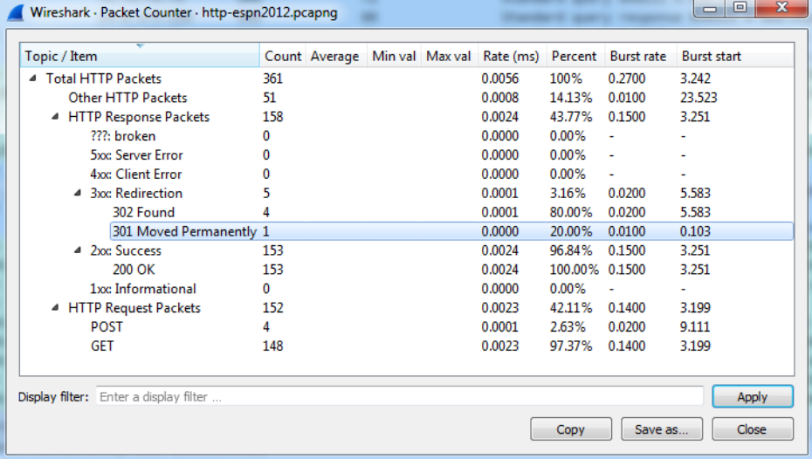
TRACE STATISTICS
Flow Graph and HTTP Statistics
• Statistics > Flow Graph draws the exchange between hosts as a ladder diagram.
• Statistics > HTTP > Packet Counter summarises requests and response codes.
• Use both to explain sequence and outcome in a report.
Statistics | HTTP | Packet Counter
Wireshark Network Analysis Masterclass (C1123) · C1123
© 2026 Tertiary Infotech Academy Pte Ltd
116

Slide 118
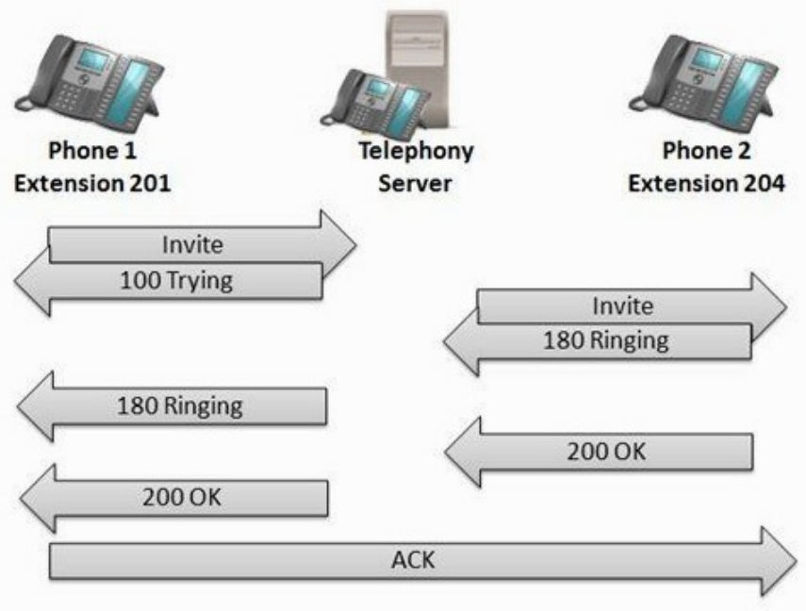
VOIP
Voice over IP (VoIP)
• SIP signals the call: INVITE, 100 Trying, 180 Ringing, 200 OK, ACK.
• RTP carries the media; gaps in RTP sequence numbers indicate loss.
• Telephony > VoIP Calls, SIP Flows and RTP Streams analyse calls.
SIP call set-up between two phones and a telephony server
Wireshark Network Analysis Masterclass (C1123) · C1123
© 2026 Tertiary Infotech Academy Pte Ltd
117

Slide 119
TOPIC 06 · HANDS-ON
Summarize traffic and a voice stream
LAB 6
Protocol Hierarchy shows captured composition; byte share differs from packet share.
You'll build
Evidence CSV and packet findings
Tools: Wireshark, TShark, Python
Wireshark Network Analysis Masterclass (C1123) · C1123
© 2026 Tertiary Infotech Academy Pte Ltd
118

Slide 120
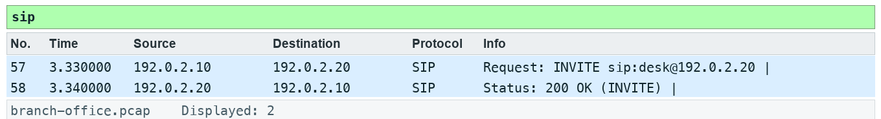
LAB 6 · EXPECTED EVIDENCE
Expected Evidence — Lab 6
Produced by TShark 4.6 from this lab's own synthetic capture with the lab filter(s) applied — your packet list should match.
Wireshark Network Analysis Masterclass (C1123) · C1123
© 2026 Tertiary Infotech Academy Pte Ltd
119

Slide 121
LAB 6
Summarize traffic and a voice stream
STEP 1 OF 6
Prepare your lab workspace. Open this lab folder in a terminal. Windows uses py -3 in place of python3. Wireshark GUI alone is sufficient for the investigation; CLI scripts require TShark on PATH. Run the fixture verification first.
1
$ python3 scripts/verify.py
Wireshark Network Analysis Masterclass (C1123) · C1123
© 2026 Tertiary Infotech Academy Pte Ltd
120

Slide 122
LAB 6
Summarize traffic and a voice stream
STEP 2 OF 6
Open data/branch-office.pcap. Open Statistics > Protocol Hierarchy, then Statistics > Conversations. Sort TCP conversations by bytes; save the largest conversation details.
2
Wireshark Network Analysis Masterclass (C1123) · C1123
© 2026 Tertiary Infotech Academy Pte Ltd
121

Slide 123
LAB 6
Summarize traffic and a voice stream
STEP 3 OF 6
Open Statistics > I/O Graphs. Create an all-traffic graph with a 1 second interval and Bits as the unit. Record peak interval and explain the difference between observed bits and usable application throughput.
3
Wireshark Network Analysis Masterclass (C1123) · C1123
© 2026 Tertiary Infotech Academy Pte Ltd
122

Slide 124
LAB 6
Summarize traffic and a voice stream
STEP 4 OF 6
Apply sip and open Telephony > VoIP Calls or SIP Flows. Identify the INVITE and 200 OK. This minimal synthetic exchange is signalling evidence, not a complete production call.
4
Wireshark Network Analysis Masterclass (C1123) · C1123
© 2026 Tertiary Infotech Academy Pte Ltd
123

Slide 125
LAB 6
Summarize traffic and a voice stream
STEP 5 OF 6
Apply udp.port == 4002. Use Analyze > Decode As to decode this UDP port as RTP. Open Telephony > RTP > RTP Streams, select the stream and Analyze. Record sequence numbers 100, 101, 103, 104; the missing sequence is 102.
5
Wireshark Network Analysis Masterclass (C1123) · C1123
© 2026 Tertiary Infotech Academy Pte Ltd
124

Slide 126
LAB 6
Summarize traffic and a voice stream
STEP 6 OF 6
Export a reproducible packet table. Record the filter, frame numbers, measurement, explanation and limitation in outputs/findings.md.
6
$ python3 scripts/export_evidence.py
Wireshark Network Analysis Masterclass (C1123) · C1123
© 2026 Tertiary Infotech Academy Pte Ltd
125

Slide 127
LAB 6 · VERIFY
Summarize traffic and a voice stream
✅ Test it
The supplied sip expression matches 2 frame(s) in the specified capture. Run scripts/verify.py and compare the listed frame numbers. Keep your findings and exported table in outputs/. Explain the observed result rather than only copying a count.
Wireshark Network Analysis Masterclass (C1123) · C1123
© 2026 Tertiary Infotech Academy Pte Ltd
126

Slide 128
TOPIC RECAP
Recap — Trace Statistics and VoIP Overview
You can now: navigate, filter, summarize and time network exchanges.
Protocol Hierarchy shows captured composition; byte share differs from packet share.
1
2
Conversations and Endpoints identify concentration; they do not alone prove malicious activity.
SIP signals a call while RTP carries media; jitter, loss and codec interpretation need stream context.
3
4
Wireshark Network Analysis Masterclass (C1123) · C1123
© 2026 Tertiary Infotech Academy Pte Ltd
127

Slide 129
Lunch Break
1 hour

Slide 130
07
TOPIC 07
Display Filters
Build a filter evidence matrix
Wireshark Network Analysis Masterclass (C1123) · C1123
© 2026 Tertiary Infotech Academy Pte Ltd
129

Slide 131
KEY CONCEPTS
Key Concepts — Display Filters
Parentheses make mixed and/or expressions explicit.
Field existence and Boolean equality differ: tcp.flags.syn == 1 tests the bit.
1
2
Since Wireshark 3.6, != uses all-not-equal semantics; historical slides describing any-not-equal are obsolete.
3
Wireshark Network Analysis Masterclass (C1123) · C1123
© 2026 Tertiary Infotech Academy Pte Ltd
130

Slide 132
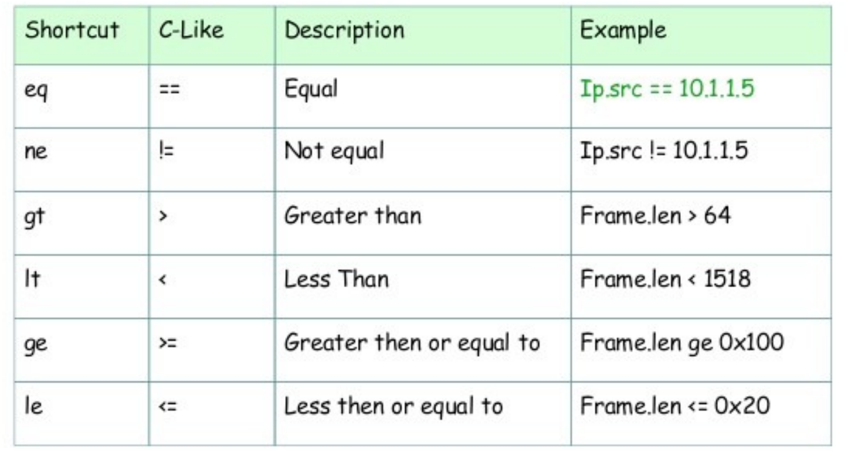
SYNTAX
Display Filter Operators
• Comparison: == != > < >= <= (or eq ne gt lt ge le).
• Logical: && (and), || (or), ! (not); parentheses make intent explicit.
• Strings in double quotes; contains and matches search payload text.
Comparison operators with C-like and English forms
Wireshark Network Analysis Masterclass (C1123) · C1123
© 2026 Tertiary Infotech Academy Pte Ltd
131

Slide 133
COMMON MISTAKE
The != Trap (Wireshark 3.6+)
ip.addr != 10.2.4.1
ip.addr ~= 10.2.4.1
• Means ALL ip.addr fields are not 10.2.4.1
• Excludes every packet to OR from 10.2.4.1
• This is the current behaviour
• "Any not equal" — the old meaning of !=
• Keeps packets where either address differs
• Prefer !(ip.addr == 10.2.4.1) for clarity
Wireshark Network Analysis Masterclass (C1123) · C1123
© 2026 Tertiary Infotech Academy Pte Ltd
132

Slide 134
TECHNIQUES
Filter Building Techniques
Right-click a field > Apply as Filter / Prepare as Filter.
Start typing — autocomplete lists valid field names.
1
2
Save frequent filters as filter buttons in your profile.
Test field existence (tcp.analysis.flags) vs a value (tcp.flags.syn == 1).
3
4
Wireshark Network Analysis Masterclass (C1123) · C1123
© 2026 Tertiary Infotech Academy Pte Ltd
133

Slide 135
CHEAT SHEET
Filters You Will Use All Week
arp || icmp
Local resolution and reachability
dns.flags.rcode != 0
DNS errors
1
2
tcp.flags.syn == 1 && tcp.flags.ack == 0
Connection attempts
tcp.analysis.flags
All TCP expert warnings
3
4
http.response.code >= 400
Client and server errors
frame.time_delta_displayed > 1
Gaps over 1 s in the view
5
6
Wireshark Network Analysis Masterclass (C1123) · C1123
© 2026 Tertiary Infotech Academy Pte Ltd
134

Slide 136
TOPIC 07 · HANDS-ON
Build a filter evidence matrix
LAB 7
Parentheses make mixed and/or expressions explicit.
You'll build
Evidence CSV and packet findings
Tools: Wireshark, TShark, Python
Wireshark Network Analysis Masterclass (C1123) · C1123
© 2026 Tertiary Infotech Academy Pte Ltd
135

Slide 137
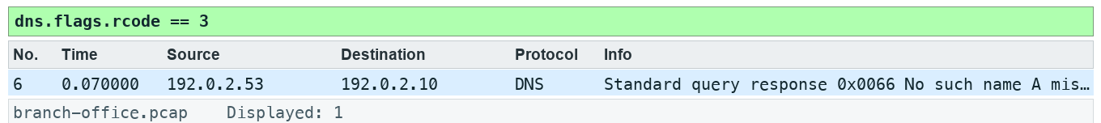
LAB 7 · EXPECTED EVIDENCE
Expected Evidence — Lab 7
Produced by TShark 4.6 from this lab's own synthetic capture with the lab filter(s) applied — your packet list should match.
Wireshark Network Analysis Masterclass (C1123) · C1123
© 2026 Tertiary Infotech Academy Pte Ltd
136

Slide 138
LAB 7
Build a filter evidence matrix
STEP 1 OF 6
Prepare your lab workspace. Open this lab folder in a terminal. Windows uses py -3 in place of python3. Wireshark GUI alone is sufficient for the investigation; CLI scripts require TShark on PATH. Run the fixture verification first.
1
$ python3 scripts/verify.py
Wireshark Network Analysis Masterclass (C1123) · C1123
© 2026 Tertiary Infotech Academy Pte Ltd
137

Slide 139
LAB 7
Build a filter evidence matrix
STEP 2 OF 6
Open data/branch-office.pcap. Apply dns.flags.rcode == 3 and record the returned response frame. Clear the filter and apply tcp.flags.syn == 1.
2
Wireshark Network Analysis Masterclass (C1123) · C1123
© 2026 Tertiary Infotech Academy Pte Ltd
138

Slide 140
LAB 7
Build a filter evidence matrix
STEP 3 OF 6
Compare (ip.src == 192.0.2.10 && udp.port == 53) || tcp.port == 80 with ip.src == 192.0.2.10 && (udp.port == 53 || tcp.port == 80). Record both counts and the direction excluded by the second expression.
3
Wireshark Network Analysis Masterclass (C1123) · C1123
© 2026 Tertiary Infotech Academy Pte Ltd
139

Slide 141
LAB 7
Build a filter evidence matrix
STEP 4 OF 6
Apply !(ip.addr == 192.0.2.53). Verify that DNS packets disappear; compare ip.addr != 192.0.2.53 on Wireshark 4.6 or later. Record the actual version and equality behaviour.
4
Wireshark Network Analysis Masterclass (C1123) · C1123
© 2026 Tertiary Infotech Academy Pte Ltd
140

Slide 142
LAB 7
Build a filter evidence matrix
STEP 5 OF 6
Save five useful filters in outputs/filters.txt. For each, state the question, filter and matching frame numbers; compile them with scripts/verify.py.
5
Wireshark Network Analysis Masterclass (C1123) · C1123
© 2026 Tertiary Infotech Academy Pte Ltd
141

Slide 143
LAB 7
Build a filter evidence matrix
STEP 6 OF 6
Export a reproducible packet table. Record the filter, frame numbers, measurement, explanation and limitation in outputs/findings.md.
6
$ python3 scripts/export_evidence.py
Wireshark Network Analysis Masterclass (C1123) · C1123
© 2026 Tertiary Infotech Academy Pte Ltd
142

Slide 144
LAB 7 · VERIFY
Build a filter evidence matrix
✅ Test it
The supplied dns.flags.rcode == 3 expression matches 1 frame(s) in the specified capture. Run scripts/verify.py and compare the listed frame numbers. Keep your findings and exported table in outputs/. Explain the observed result rather than only copying a count.
Wireshark Network Analysis Masterclass (C1123) · C1123
© 2026 Tertiary Infotech Academy Pte Ltd
143

Slide 145
TOPIC RECAP
Recap — Display Filters
You can now: navigate, filter, summarize and time network exchanges.
Parentheses make mixed and/or expressions explicit.
1
2
Field existence and Boolean equality differ: tcp.flags.syn == 1 tests the bit.
Since Wireshark 3.6, != uses all-not-equal semantics; historical slides describing any-not-equal are obsolete.
3
4
Wireshark Network Analysis Masterclass (C1123) · C1123
© 2026 Tertiary Infotech Academy Pte Ltd
144

Slide 146
08
TOPIC 08
TCP/IP Communications and Resolution
Reconstruct an application dependency chain
Wireshark Network Analysis Masterclass (C1123) · C1123
© 2026 Tertiary Infotech Academy Pte Ltd
145

Slide 147
KEY CONCEPTS
Key Concepts — TCP/IP Communications and Resolution
ARP resolves a local next-hop MAC; DNS resolves a name to an address.
The destination IP stays end-to-end across routing while link-layer addresses change per hop.
1
2
Resolution, connection establishment and application exchange form a dependency chain.
3
Wireshark Network Analysis Masterclass (C1123) · C1123
© 2026 Tertiary Infotech Academy Pte Ltd
146

Slide 148
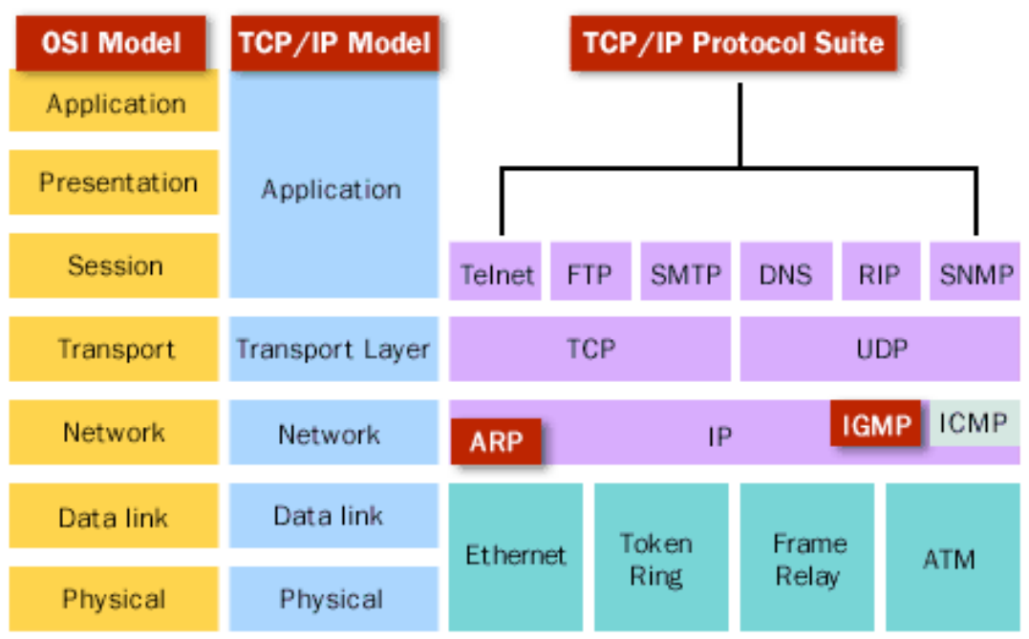
PROTOCOL SUITE
The TCP/IP Protocol Suite
• Application: HTTP, DNS, SMTP, SNMP …
• Transport: TCP (reliable) and UDP (best-effort).
• Network: IP, ICMP, ARP sits between network and link.
Where common protocols sit
Wireshark Network Analysis Masterclass (C1123) · C1123
© 2026 Tertiary Infotech Academy Pte Ltd
147

Slide 149
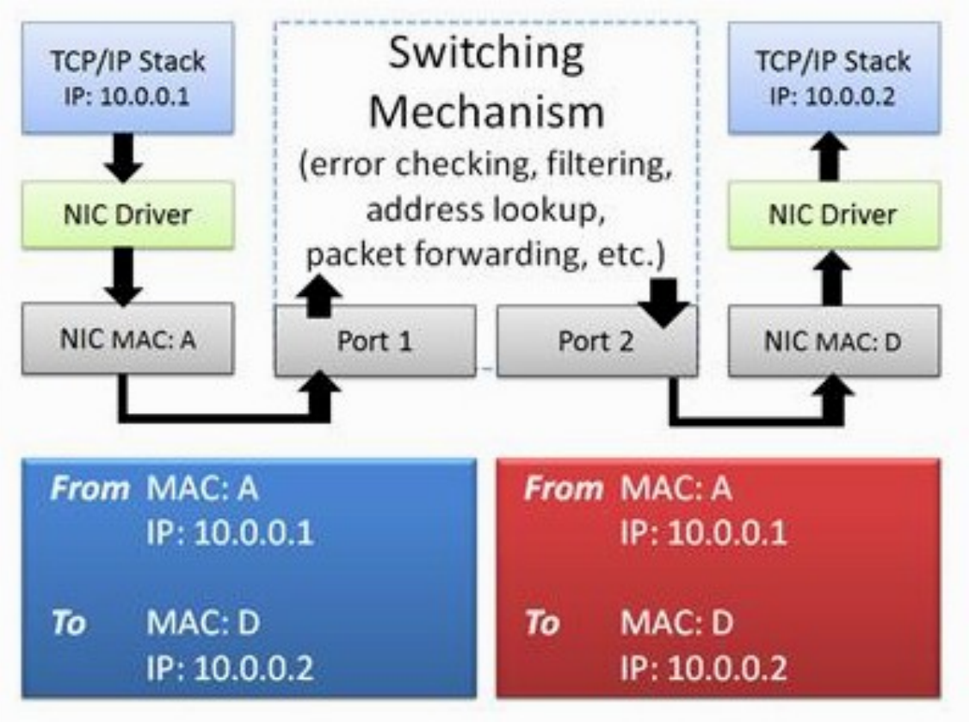
LAYER 2
Switching Overview
• Switches learn MAC addresses and forward frames within a broadcast domain.
• Source and destination MAC stay the same across a switch.
• ARP resolves the next-hop MAC before the first frame is sent.
A frame crossing a switch keeps its MAC addresses
Wireshark Network Analysis Masterclass (C1123) · C1123
© 2026 Tertiary Infotech Academy Pte Ltd
148

Slide 150
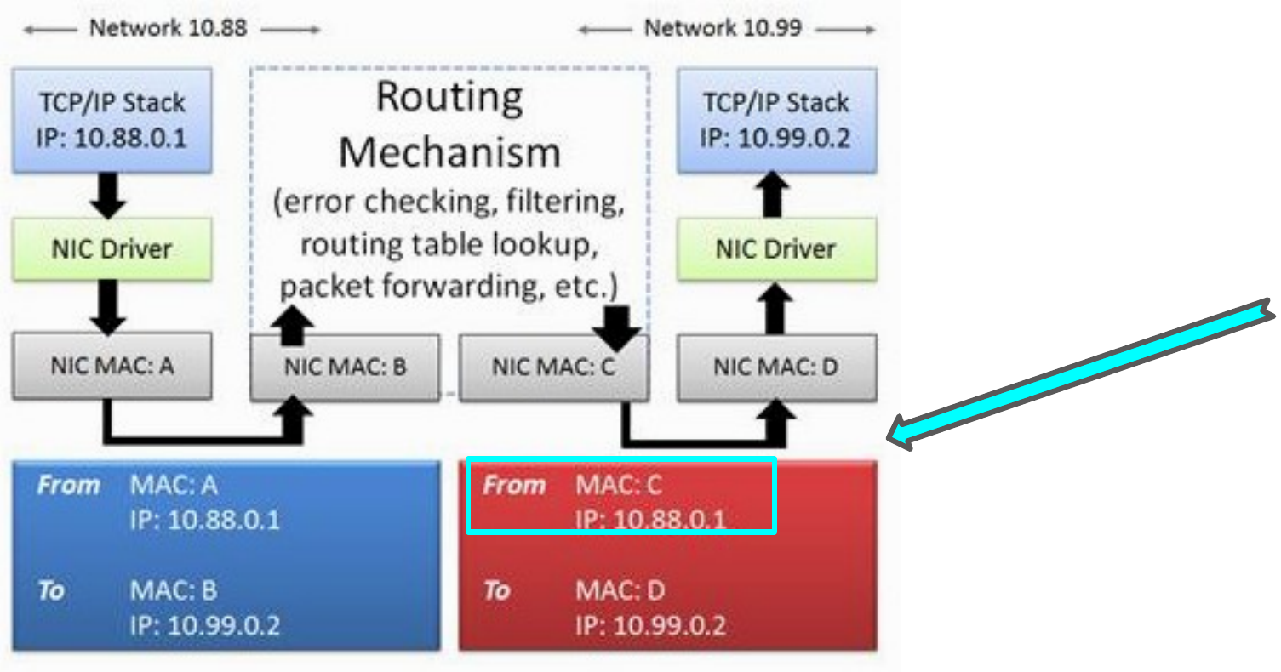
LAYER 3
Routing Overview
• Routers forward on destination IP and rewrite the link-layer addresses.
• TTL decreases by one at every router hop.
• The IP addresses are unchanged across routers (without NAT).
MAC addresses change hop-by-hop; IP addresses stay end-to-end
Wireshark Network Analysis Masterclass (C1123) · C1123
© 2026 Tertiary Infotech Academy Pte Ltd
149

Slide 151
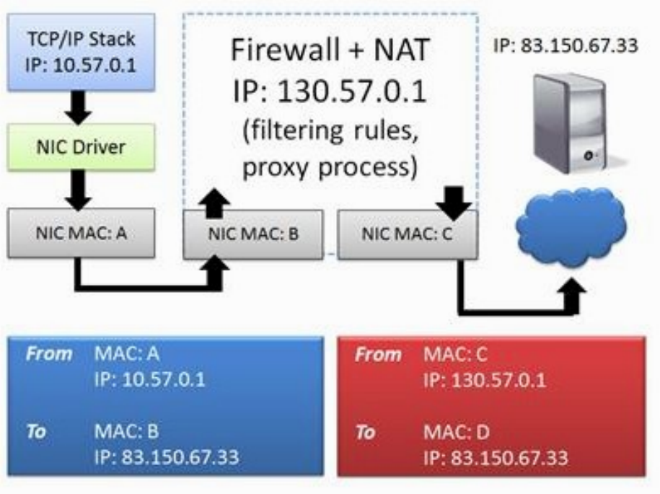
MIDDLEBOXES
Firewalls and NAT
• NAT/PAT rewrites addresses and ports — capture on both sides to correlate.
• Firewalls may drop silently or reply with RST / ICMP unreachable.
• A proxy creates two separate TCP connections.
Address translation changes what each capture point sees
Wireshark Network Analysis Masterclass (C1123) · C1123
© 2026 Tertiary Infotech Academy Pte Ltd
150

Slide 152
RECONSTRUCT THE STORY
The Dependency Chain
1
2
3
4
5
▶
▶
▶
▶
ARP resolves the gateway MAC
DNS resolves the server name
TCP handshake opens the connection
Application request and response
Teardown: FIN or RST
Wireshark Network Analysis Masterclass (C1123) · C1123
© 2026 Tertiary Infotech Academy Pte Ltd
151

Slide 153
TOPIC 08 · HANDS-ON
Reconstruct an application dependency chain
LAB 8
ARP resolves a local next-hop MAC; DNS resolves a name to an address.
You'll build
Evidence CSV and packet findings
Tools: Wireshark, TShark, Python
Wireshark Network Analysis Masterclass (C1123) · C1123
© 2026 Tertiary Infotech Academy Pte Ltd
152

Slide 154
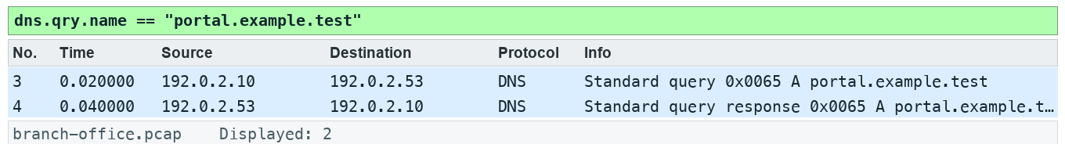
LAB 8 · EXPECTED EVIDENCE
Expected Evidence — Lab 8
Produced by TShark 4.6 from this lab's own synthetic capture with the lab filter(s) applied — your packet list should match.
Wireshark Network Analysis Masterclass (C1123) · C1123
© 2026 Tertiary Infotech Academy Pte Ltd
153

Slide 155
LAB 8
Reconstruct an application dependency chain
STEP 1 OF 6
Prepare your lab workspace. Open this lab folder in a terminal. Windows uses py -3 in place of python3. Wireshark GUI alone is sufficient for the investigation; CLI scripts require TShark on PATH. Run the fixture verification first.
1
$ python3 scripts/verify.py
Wireshark Network Analysis Masterclass (C1123) · C1123
© 2026 Tertiary Infotech Academy Pte Ltd
154

Slide 156
LAB 8
Reconstruct an application dependency chain
STEP 2 OF 6
Open data/branch-office.pcap. Locate the ARP exchange and DNS transaction 101 for portal.example.test. Record the server address 192.0.2.20.
2
Wireshark Network Analysis Masterclass (C1123) · C1123
© 2026 Tertiary Infotech Academy Pte Ltd
155

Slide 157
LAB 8
Reconstruct an application dependency chain
STEP 3 OF 6
Apply tcp.stream == 0 and open Statistics > Flow Graph with displayed packets selected. Identify SYN, SYN/ACK, ACK, request and response.
3
Wireshark Network Analysis Masterclass (C1123) · C1123
© 2026 Tertiary Infotech Academy Pte Ltd
156

Slide 158
LAB 8
Reconstruct an application dependency chain
STEP 4 OF 6
Fill assets/dependency-map.md with the ARP, DNS, TCP and HTTP frame ranges. Distinguish Ethernet next hop from IP destination.
4
Wireshark Network Analysis Masterclass (C1123) · C1123
© 2026 Tertiary Infotech Academy Pte Ltd
157

Slide 159
LAB 8
Reconstruct an application dependency chain
STEP 5 OF 6
Contrast a same-subnet server with a routed server using assets/topology.md: a routed destination needs the gateway MAC rather than ARP for the remote host. Record what this trace can and cannot demonstrate.
5
Wireshark Network Analysis Masterclass (C1123) · C1123
© 2026 Tertiary Infotech Academy Pte Ltd
158

Slide 160
LAB 8
Reconstruct an application dependency chain
STEP 6 OF 6
Export a reproducible packet table. Record the filter, frame numbers, measurement, explanation and limitation in outputs/findings.md.
6
$ python3 scripts/export_evidence.py
Wireshark Network Analysis Masterclass (C1123) · C1123
© 2026 Tertiary Infotech Academy Pte Ltd
159

Slide 161
LAB 8 · VERIFY
Reconstruct an application dependency chain
✅ Test it
The supplied dns.qry.name == "portal.example.test" expression matches 2 frame(s) in the specified capture. Run scripts/verify.py and compare the listed frame numbers. Keep your findings and exported table in outputs/. Explain the observed result rather than only copying a count.
Wireshark Network Analysis Masterclass (C1123) · C1123
© 2026 Tertiary Infotech Academy Pte Ltd
160

Slide 162
TOPIC RECAP
Recap — TCP/IP Communications and Resolution
You can now: navigate, filter, summarize and time network exchanges.
ARP resolves a local next-hop MAC; DNS resolves a name to an address.
1
2
The destination IP stays end-to-end across routing while link-layer addresses change per hop.
Resolution, connection establishment and application exchange form a dependency chain.
3
4
Wireshark Network Analysis Masterclass (C1123) · C1123
© 2026 Tertiary Infotech Academy Pte Ltd
161

Slide 163
Tea Break
15 minutes

Slide 164
09
TOPIC 09
DNS Traffic Analysis
Diagnose DNS failure and delay
Wireshark Network Analysis Masterclass (C1123) · C1123
© 2026 Tertiary Infotech Academy Pte Ltd
163

Slide 165
KEY CONCEPTS
Key Concepts — DNS Traffic Analysis
Transaction ID plus addresses and ports pair a query with its response.
NXDOMAIN reports that a name does not exist; it differs from silence or timeout.
1
2
DNS response time is a measured exchange, influenced by resolver and path behaviour.
3
Wireshark Network Analysis Masterclass (C1123) · C1123
© 2026 Tertiary Infotech Academy Pte Ltd
164

Slide 166
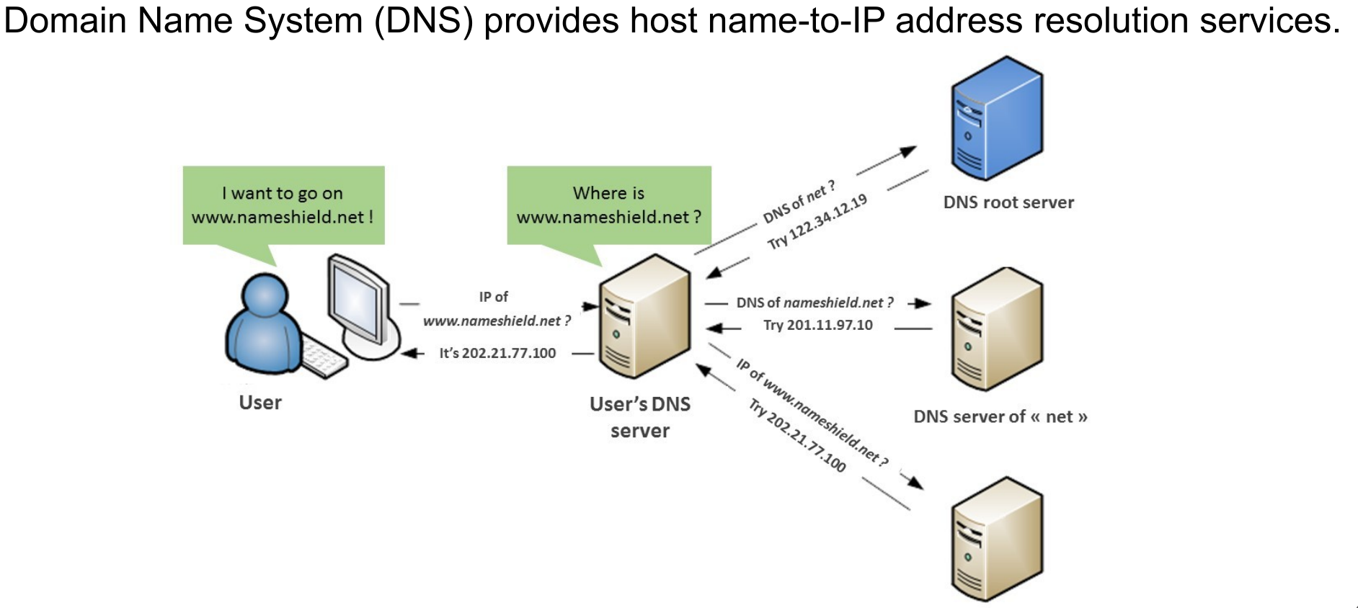
DNS
How DNS Works
• The client asks its resolver; the resolver walks the hierarchy or answers from cache.
• Queries normally use UDP 53; large answers and zone transfers use TCP.
• Transaction ID pairs each response with its query.
Name resolution through a local resolver
Wireshark Network Analysis Masterclass (C1123) · C1123
© 2026 Tertiary Infotech Academy Pte Ltd
165

Slide 167
DNS OUTCOMES
Reading DNS Evidence
Success
Failure
Silence
• rcode 0 (NoError)
• Answer records present
• Check TTL and address
• rcode 3 = NXDOMAIN
• rcode 2 = SERVFAIL
• Name or zone problem
• Query with no response
• Retries after timeout
• Path, firewall or resolver
Wireshark Network Analysis Masterclass (C1123) · C1123
© 2026 Tertiary Infotech Academy Pte Ltd
166

Slide 168
FILTERS
Useful DNS Filters
dns.flags.response == 0 — queries only.
dns.flags.rcode == 3 — name does not exist.
1
2
dns.time > 0.5 — responses slower than 500 ms.
dns.qry.name contains "example" — one domain family.
3
4
Wireshark Network Analysis Masterclass (C1123) · C1123
© 2026 Tertiary Infotech Academy Pte Ltd
167

Slide 169
TOPIC 09 · HANDS-ON
Diagnose DNS failure and delay
LAB 9
Transaction ID plus addresses and ports pair a query with its response.
You'll build
Evidence CSV and packet findings
Tools: Wireshark, TShark, Python
Wireshark Network Analysis Masterclass (C1123) · C1123
© 2026 Tertiary Infotech Academy Pte Ltd
168

Slide 170
LAB 9 · EXPECTED EVIDENCE
Expected Evidence — Lab 9
Produced by TShark 4.6 from this lab's own synthetic capture with the lab filter(s) applied — your packet list should match.
Wireshark Network Analysis Masterclass (C1123) · C1123
© 2026 Tertiary Infotech Academy Pte Ltd
169

Slide 171
LAB 9
Diagnose DNS failure and delay
STEP 1 OF 6
Prepare your lab workspace. Open this lab folder in a terminal. Windows uses py -3 in place of python3. Wireshark GUI alone is sufficient for the investigation; CLI scripts require TShark on PATH. Run the fixture verification first.
1
$ python3 scripts/verify.py
Wireshark Network Analysis Masterclass (C1123) · C1123
© 2026 Tertiary Infotech Academy Pte Ltd
170

Slide 172
LAB 9
Diagnose DNS failure and delay
STEP 2 OF 6
Open data/branch-office.pcap. Apply dns and add dns.time as a column from a response packet. Pair IDs 101, 102 and 103.
2
Wireshark Network Analysis Masterclass (C1123) · C1123
© 2026 Tertiary Infotech Academy Pte Ltd
171

Slide 173
LAB 9
Diagnose DNS failure and delay
STEP 3 OF 6
Apply dns.flags.rcode == 3. Expand DNS flags and name. Record missing.example.test and explain NXDOMAIN.
3
Wireshark Network Analysis Masterclass (C1123) · C1123
© 2026 Tertiary Infotech Academy Pte Ltd
172

Slide 174
LAB 9
Diagnose DNS failure and delay
STEP 4 OF 6
Apply dns.id == 103. Measure the query-response interval: 0.800 seconds. Compare with the two 0.020 second transactions.
4
Wireshark Network Analysis Masterclass (C1123) · C1123
© 2026 Tertiary Infotech Academy Pte Ltd
173

Slide 175
LAB 9
Diagnose DNS failure and delay
STEP 5 OF 6
Complete assets/dns-observations.csv with name, transaction ID, rcode, elapsed seconds and next investigation. Do not label this measured delay as a DNS timeout.
5
Wireshark Network Analysis Masterclass (C1123) · C1123
© 2026 Tertiary Infotech Academy Pte Ltd
174

Slide 176
LAB 9
Diagnose DNS failure and delay
STEP 6 OF 6
Export a reproducible packet table. Record the filter, frame numbers, measurement, explanation and limitation in outputs/findings.md.
6
$ python3 scripts/export_evidence.py
Wireshark Network Analysis Masterclass (C1123) · C1123
© 2026 Tertiary Infotech Academy Pte Ltd
175

Slide 177
LAB 9 · VERIFY
Diagnose DNS failure and delay
✅ Test it
The supplied dns.flags.rcode == 3 expression matches 1 frame(s) in the specified capture. Run scripts/verify.py and compare the listed frame numbers. Keep your findings and exported table in outputs/. Explain the observed result rather than only copying a count.
Wireshark Network Analysis Masterclass (C1123) · C1123
© 2026 Tertiary Infotech Academy Pte Ltd
176

Slide 178
TOPIC RECAP
Recap — DNS Traffic Analysis
You can now: interpret DNS, ARP, IPv4, ICMP and UDP evidence.
Transaction ID plus addresses and ports pair a query with its response.
1
2
NXDOMAIN reports that a name does not exist; it differs from silence or timeout.
DNS response time is a measured exchange, influenced by resolver and path behaviour.
3
4
Wireshark Network Analysis Masterclass (C1123) · C1123
© 2026 Tertiary Infotech Academy Pte Ltd
177

Slide 179
End of Day 2
See you tomorrow

Slide 180
D3
DAY 3
IP and transport diagnostics
Recap of the previous day, then today's topics and labs
Wireshark Network Analysis Masterclass (C1123) · C1123
© 2026 Tertiary Infotech Academy Pte Ltd
179

Slide 181
10
TOPIC 10
ARP Traffic Analysis
Verify link-local resolution
Wireshark Network Analysis Masterclass (C1123) · C1123
© 2026 Tertiary Infotech Academy Pte Ltd
180

Slide 182
KEY CONCEPTS
Key Concepts — ARP Traffic Analysis
ARP requests are link-local broadcasts; replies usually return to the requester.
A repeated unresolved request suggests a local resolution problem, but a single trace may miss the reply.
1
2
MAC changes require corroboration before claiming duplicate IP or spoofing.
3
Wireshark Network Analysis Masterclass (C1123) · C1123
© 2026 Tertiary Infotech Academy Pte Ltd
181

Slide 183
ADDRESS RESOLUTION
ARP in Practice
Request
Reply
Gratuitous
• Broadcast to ff:ff:ff:ff:ff:ff
• "Who has 192.0.2.20? Tell 192.0.2.10"
• arp.opcode == 1
• Unicast back to the requester
• "192.0.2.20 is at 02:00:…"
• arp.opcode == 2
• Sender announces its own IP
• Used after failover / IP change
• arp.isgratuitous
Wireshark Network Analysis Masterclass (C1123) · C1123
© 2026 Tertiary Infotech Academy Pte Ltd
182

Slide 184
DIAGNOSIS
ARP Problems to Recognise
Symptoms
Possible causes
• Repeated requests with no reply
• Duplicate IP address detected warnings
• One IP mapped to two MAC addresses
• Excessive ARP broadcasts
• Host down or wrong subnet
• Two hosts configured with the same IP
• ARP spoofing — corroborate first
• Scanning or misconfigured devices
Wireshark Network Analysis Masterclass (C1123) · C1123
© 2026 Tertiary Infotech Academy Pte Ltd
183

Slide 185
TOPIC 10 · HANDS-ON
Verify link-local resolution
LAB 10
ARP requests are link-local broadcasts; replies usually return to the requester.
You'll build
Evidence CSV and packet findings
Tools: Wireshark, TShark, Python
Wireshark Network Analysis Masterclass (C1123) · C1123
© 2026 Tertiary Infotech Academy Pte Ltd
184

Slide 186
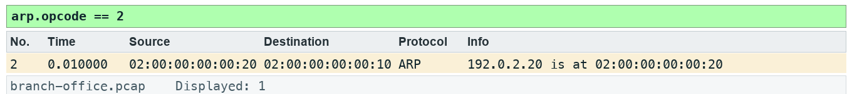
LAB 10 · EXPECTED EVIDENCE
Expected Evidence — Lab 10
Produced by TShark 4.6 from this lab's own synthetic capture with the lab filter(s) applied — your packet list should match.
Wireshark Network Analysis Masterclass (C1123) · C1123
© 2026 Tertiary Infotech Academy Pte Ltd
185

Slide 187
LAB 10
Verify link-local resolution
STEP 1 OF 6
Prepare your lab workspace. Open this lab folder in a terminal. Windows uses py -3 in place of python3. Wireshark GUI alone is sufficient for the investigation; CLI scripts require TShark on PATH. Run the fixture verification first.
1
$ python3 scripts/verify.py
Wireshark Network Analysis Masterclass (C1123) · C1123
© 2026 Tertiary Infotech Academy Pte Ltd
186

Slide 188
LAB 10
Verify link-local resolution
STEP 2 OF 6
Open data/branch-office.pcap. Apply arp. Expand the request and reply, then record sender IP, sender MAC, target IP and opcode.
2
Wireshark Network Analysis Masterclass (C1123) · C1123
© 2026 Tertiary Infotech Academy Pte Ltd
187

Slide 189
LAB 10
Verify link-local resolution
STEP 3 OF 6
Apply arp.opcode == 2. Confirm the advertised server mapping is 192.0.2.20 to 02:00:00:00:00:20.
3
Wireshark Network Analysis Masterclass (C1123) · C1123
© 2026 Tertiary Infotech Academy Pte Ltd
188

Slide 190
LAB 10
Verify link-local resolution
STEP 4 OF 6
Use the packet bytes to verify the opcode field is 2 in the reply. Add the mapping to assets/arp-table.csv.
4
Wireshark Network Analysis Masterclass (C1123) · C1123
© 2026 Tertiary Infotech Academy Pte Ltd
189

Slide 191
LAB 10
Verify link-local resolution
STEP 5 OF 6
Compare assets/arp-hypotheses.md with the evidence. State that this capture shows one successful exchange, without inventing repeated failures or conflicting MACs.
5
Wireshark Network Analysis Masterclass (C1123) · C1123
© 2026 Tertiary Infotech Academy Pte Ltd
190

Slide 192
LAB 10
Verify link-local resolution
STEP 6 OF 6
Export a reproducible packet table. Record the filter, frame numbers, measurement, explanation and limitation in outputs/findings.md.
6
$ python3 scripts/export_evidence.py
Wireshark Network Analysis Masterclass (C1123) · C1123
© 2026 Tertiary Infotech Academy Pte Ltd
191

Slide 193
LAB 10 · VERIFY
Verify link-local resolution
✅ Test it
The supplied arp.opcode == 2 expression matches 1 frame(s) in the specified capture. Run scripts/verify.py and compare the listed frame numbers. Keep your findings and exported table in outputs/. Explain the observed result rather than only copying a count.
Wireshark Network Analysis Masterclass (C1123) · C1123
© 2026 Tertiary Infotech Academy Pte Ltd
192

Slide 194
TOPIC RECAP
Recap — ARP Traffic Analysis
You can now: interpret DNS, ARP, IPv4, ICMP and UDP evidence.
ARP requests are link-local broadcasts; replies usually return to the requester.
1
2
A repeated unresolved request suggests a local resolution problem, but a single trace may miss the reply.
MAC changes require corroboration before claiming duplicate IP or spoofing.
3
4
Wireshark Network Analysis Masterclass (C1123) · C1123
© 2026 Tertiary Infotech Academy Pte Ltd
193

Slide 195
Tea Break
15 minutes

Slide 196
11
TOPIC 11
IPv4 Traffic Analysis
Classify IPv4 scope and headers
Wireshark Network Analysis Masterclass (C1123) · C1123
© 2026 Tertiary Infotech Academy Pte Ltd
195

Slide 197
KEY CONCEPTS
Key Concepts — IPv4 Traffic Analysis
TTL limits forwarding hops; it is not a latency measurement.
Broadcast and multicast use different addressing scopes and delivery rules.
1
2
Fragmentation fields describe packet handling; missing fragments can reflect capture limitations.
3
Wireshark Network Analysis Masterclass (C1123) · C1123
© 2026 Tertiary Infotech Academy Pte Ltd
196

Slide 198
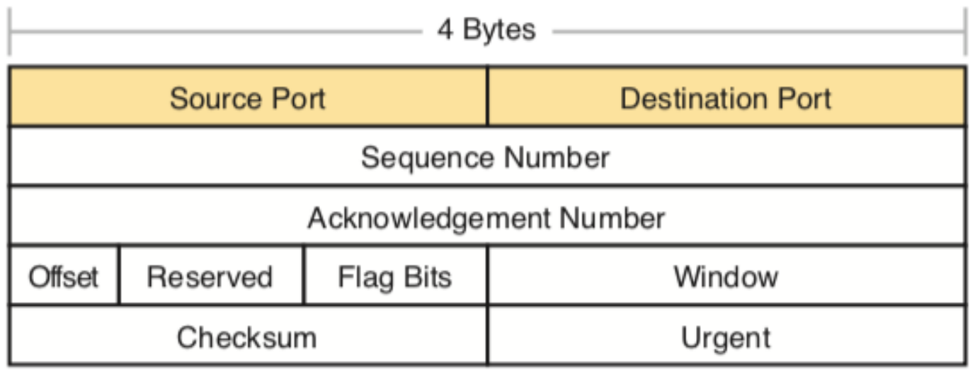
IPV4
IPv4 Header Essentials
• TTL — hops remaining; not a measure of time.
• Protocol — 1 ICMP, 6 TCP, 17 UDP.
• Flags/Fragment offset — fragmentation handling.
• DSCP — quality-of-service marking.
Header layout (TCP header shown; IPv4 uses the same 32-bit rows)
Wireshark Network Analysis Masterclass (C1123) · C1123
© 2026 Tertiary Infotech Academy Pte Ltd
197

Slide 199
SCOPE
Address Scope
Unicast
Broadcast
Multicast
• One sender to one receiver
• Most application traffic
• ip.dst == host
• All hosts on the subnet
• 255.255.255.255 or directed
• Not forwarded by routers
• 224.0.0.0/4 group addresses
• 224.0.0.1 = all hosts
• Joined with IGMP
Wireshark Network Analysis Masterclass (C1123) · C1123
© 2026 Tertiary Infotech Academy Pte Ltd
198

Slide 200
FILTERS
IPv4 Filters and Checks
ip.ttl < 10 — packets close to expiring.
ip.flags.mf == 1 || ip.frag_offset > 0 — fragments.
1
2
ip.dst == 224.0.0.0/4 — all multicast.
Missing fragments may be a capture limitation — check drops first.
3
4
Wireshark Network Analysis Masterclass (C1123) · C1123
© 2026 Tertiary Infotech Academy Pte Ltd
199

Slide 201
TOPIC 11 · HANDS-ON
Classify IPv4 scope and headers
LAB 11
TTL limits forwarding hops; it is not a latency measurement.
You'll build
Evidence CSV and packet findings
Tools: Wireshark, TShark, Python
Wireshark Network Analysis Masterclass (C1123) · C1123
© 2026 Tertiary Infotech Academy Pte Ltd
200

Slide 202
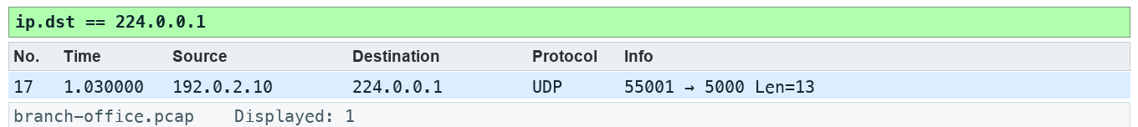
LAB 11 · EXPECTED EVIDENCE
Expected Evidence — Lab 11
Produced by TShark 4.6 from this lab's own synthetic capture with the lab filter(s) applied — your packet list should match.
Wireshark Network Analysis Masterclass (C1123) · C1123
© 2026 Tertiary Infotech Academy Pte Ltd
201

Slide 203
LAB 11
Classify IPv4 scope and headers
STEP 1 OF 6
Prepare your lab workspace. Open this lab folder in a terminal. Windows uses py -3 in place of python3. Wireshark GUI alone is sufficient for the investigation; CLI scripts require TShark on PATH. Run the fixture verification first.
1
$ python3 scripts/verify.py
Wireshark Network Analysis Masterclass (C1123) · C1123
© 2026 Tertiary Infotech Academy Pte Ltd
202

Slide 204
LAB 11
Classify IPv4 scope and headers
STEP 2 OF 6
Open data/branch-office.pcap. Select an ICMP echo request. Expand IPv4 and record version, IHL, total length, TTL, protocol, flags and fragment offset.
2
Wireshark Network Analysis Masterclass (C1123) · C1123
© 2026 Tertiary Infotech Academy Pte Ltd
203

Slide 205
LAB 11
Classify IPv4 scope and headers
STEP 3 OF 6
Apply ip.dst == 224.0.0.1 and compare Ethernet destination 01:00:5e:00:00:01 with IPv4 multicast destination. Record TTL 1.
3
Wireshark Network Analysis Masterclass (C1123) · C1123
© 2026 Tertiary Infotech Academy Pte Ltd
204

Slide 206
LAB 11
Classify IPv4 scope and headers
STEP 4 OF 6
Apply ip.flags.mf == 1 || ip.frag_offset > 0. Confirm no fragmented packets in this fixture; absence here does not demonstrate a universal MTU.
4
Wireshark Network Analysis Masterclass (C1123) · C1123
© 2026 Tertiary Infotech Academy Pte Ltd
205

Slide 207
LAB 11
Classify IPv4 scope and headers
STEP 5 OF 6
Complete assets/ip-header.csv. Explain why ARP broadcast is not an IPv4 broadcast packet, and why a capture at one point cannot estimate hop count from TTL without knowing initial TTL.
5
Wireshark Network Analysis Masterclass (C1123) · C1123
© 2026 Tertiary Infotech Academy Pte Ltd
206

Slide 208
LAB 11
Classify IPv4 scope and headers
STEP 6 OF 6
Export a reproducible packet table. Record the filter, frame numbers, measurement, explanation and limitation in outputs/findings.md.
6
$ python3 scripts/export_evidence.py
Wireshark Network Analysis Masterclass (C1123) · C1123
© 2026 Tertiary Infotech Academy Pte Ltd
207

Slide 209
LAB 11 · VERIFY
Classify IPv4 scope and headers
✅ Test it
The supplied ip.dst == 224.0.0.1 expression matches 1 frame(s) in the specified capture. Run scripts/verify.py and compare the listed frame numbers. Keep your findings and exported table in outputs/. Explain the observed result rather than only copying a count.
Wireshark Network Analysis Masterclass (C1123) · C1123
© 2026 Tertiary Infotech Academy Pte Ltd
208

Slide 210
TOPIC RECAP
Recap — IPv4 Traffic Analysis
You can now: interpret DNS, ARP, IPv4, ICMP and UDP evidence.
TTL limits forwarding hops; it is not a latency measurement.
1
2
Broadcast and multicast use different addressing scopes and delivery rules.
Fragmentation fields describe packet handling; missing fragments can reflect capture limitations.
3
4
Wireshark Network Analysis Masterclass (C1123) · C1123
© 2026 Tertiary Infotech Academy Pte Ltd
209

Slide 211
Lunch Break
1 hour

Slide 212
12
TOPIC 12
ICMP Traffic Analysis
Interpret echo and unreachable messages
Wireshark Network Analysis Masterclass (C1123) · C1123
© 2026 Tertiary Infotech Academy Pte Ltd
211

Slide 213
KEY CONCEPTS
Key Concepts — ICMP Traffic Analysis
Echo requests/replies show an IP exchange; they do not guarantee an application works.
Destination unreachable messages quote the offending datagram.
1
2
ICMP may be filtered or rate-limited, so absence of a reply needs cautious interpretation.
3
Wireshark Network Analysis Masterclass (C1123) · C1123
© 2026 Tertiary Infotech Academy Pte Ltd
212

Slide 214
ICMP
ICMP Messages to Know
Echo
Unreachable
Time exceeded
• Type 8 request, Type 0 reply
• ping / reachability
• Match on identifier + sequence
• Type 3
• Code 3 = port unreachable
• Code 1 = host unreachable
• Type 11
• TTL expired in transit
• How traceroute works
Wireshark Network Analysis Masterclass (C1123) · C1123
© 2026 Tertiary Infotech Academy Pte Ltd
213

Slide 215
INTERPRETATION
Interpreting ICMP Evidence
An unreachable message quotes the original IP header — read it to find the failed flow.
No echo reply can mean filtering, not a down host.
1
2
Rate-limited ICMP can hide real loss.
icmp.type == 3 && icmp.code == 3 finds closed UDP ports.
3
4
Wireshark Network Analysis Masterclass (C1123) · C1123
© 2026 Tertiary Infotech Academy Pte Ltd
214

Slide 216
TOPIC 12 · HANDS-ON
Interpret echo and unreachable messages
LAB 12
Echo requests/replies show an IP exchange; they do not guarantee an application works.
You'll build
Evidence CSV and packet findings
Tools: Wireshark, TShark, Python
Wireshark Network Analysis Masterclass (C1123) · C1123
© 2026 Tertiary Infotech Academy Pte Ltd
215

Slide 217
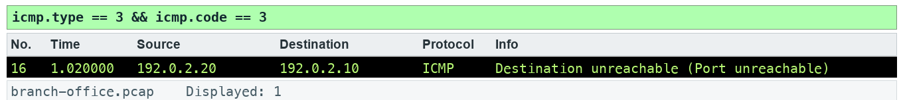
LAB 12 · EXPECTED EVIDENCE
Expected Evidence — Lab 12
Produced by TShark 4.6 from this lab's own synthetic capture with the lab filter(s) applied — your packet list should match.
Wireshark Network Analysis Masterclass (C1123) · C1123
© 2026 Tertiary Infotech Academy Pte Ltd
216

Slide 218
LAB 12
Interpret echo and unreachable messages
STEP 1 OF 6
Prepare your lab workspace. Open this lab folder in a terminal. Windows uses py -3 in place of python3. Wireshark GUI alone is sufficient for the investigation; CLI scripts require TShark on PATH. Run the fixture verification first.
1
$ python3 scripts/verify.py
Wireshark Network Analysis Masterclass (C1123) · C1123
© 2026 Tertiary Infotech Academy Pte Ltd
217

Slide 219
LAB 12
Interpret echo and unreachable messages
STEP 2 OF 6
Open data/branch-office.pcap. Apply icmp.type == 8 || icmp.type == 0. Pair echo sequences 0, 1 and 2 using identifier 7. Measure 0.030 seconds per pair.
2
Wireshark Network Analysis Masterclass (C1123) · C1123
© 2026 Tertiary Infotech Academy Pte Ltd
218

Slide 220
LAB 12
Interpret echo and unreachable messages
STEP 3 OF 6
Apply icmp.type == 3 && icmp.code == 3. Expand the quoted IPv4 and UDP headers. Record destination UDP port 9999.
3
Wireshark Network Analysis Masterclass (C1123) · C1123
© 2026 Tertiary Infotech Academy Pte Ltd
219

Slide 221
LAB 12
Interpret echo and unreachable messages
STEP 4 OF 6
Apply udp.dstport == 9999 to locate the initiating datagram. Record the difference between a UDP service refusal and an echo reply.
4
Wireshark Network Analysis Masterclass (C1123) · C1123
© 2026 Tertiary Infotech Academy Pte Ltd
220

Slide 222
LAB 12
Interpret echo and unreachable messages
STEP 5 OF 6
Complete assets/icmp-events.csv with type, code, quoted protocol, port and conclusion. State which evidence supports a service refusal.
5
Wireshark Network Analysis Masterclass (C1123) · C1123
© 2026 Tertiary Infotech Academy Pte Ltd
221

Slide 223
LAB 12
Interpret echo and unreachable messages
STEP 6 OF 6
Export a reproducible packet table. Record the filter, frame numbers, measurement, explanation and limitation in outputs/findings.md.
6
$ python3 scripts/export_evidence.py
Wireshark Network Analysis Masterclass (C1123) · C1123
© 2026 Tertiary Infotech Academy Pte Ltd
222

Slide 224
LAB 12 · VERIFY
Interpret echo and unreachable messages
✅ Test it
The supplied icmp.type == 3 && icmp.code == 3 expression matches 1 frame(s) in the specified capture. Run scripts/verify.py and compare the listed frame numbers. Keep your findings and exported table in outputs/. Explain the observed result rather than only copying a count.
Wireshark Network Analysis Masterclass (C1123) · C1123
© 2026 Tertiary Infotech Academy Pte Ltd
223

Slide 225
TOPIC RECAP
Recap — ICMP Traffic Analysis
You can now: interpret DNS, ARP, IPv4, ICMP and UDP evidence.
Echo requests/replies show an IP exchange; they do not guarantee an application works.
1
2
Destination unreachable messages quote the offending datagram.
ICMP may be filtered or rate-limited, so absence of a reply needs cautious interpretation.
3
4
Wireshark Network Analysis Masterclass (C1123) · C1123
© 2026 Tertiary Infotech Academy Pte Ltd
224

Slide 226
13
TOPIC 13
UDP Traffic Analysis
Follow datagrams and service refusal
Wireshark Network Analysis Masterclass (C1123) · C1123
© 2026 Tertiary Infotech Academy Pte Ltd
225

Slide 227
KEY CONCEPTS
Key Concepts — UDP Traffic Analysis
UDP has no transport handshake or retransmission; the application may provide reliability.
A port number is a decoding hint; payload and context identify the application.
1
2
Following a UDP stream collects datagrams and does not invent missing data.
3
Wireshark Network Analysis Masterclass (C1123) · C1123
© 2026 Tertiary Infotech Academy Pte Ltd
226

Slide 228
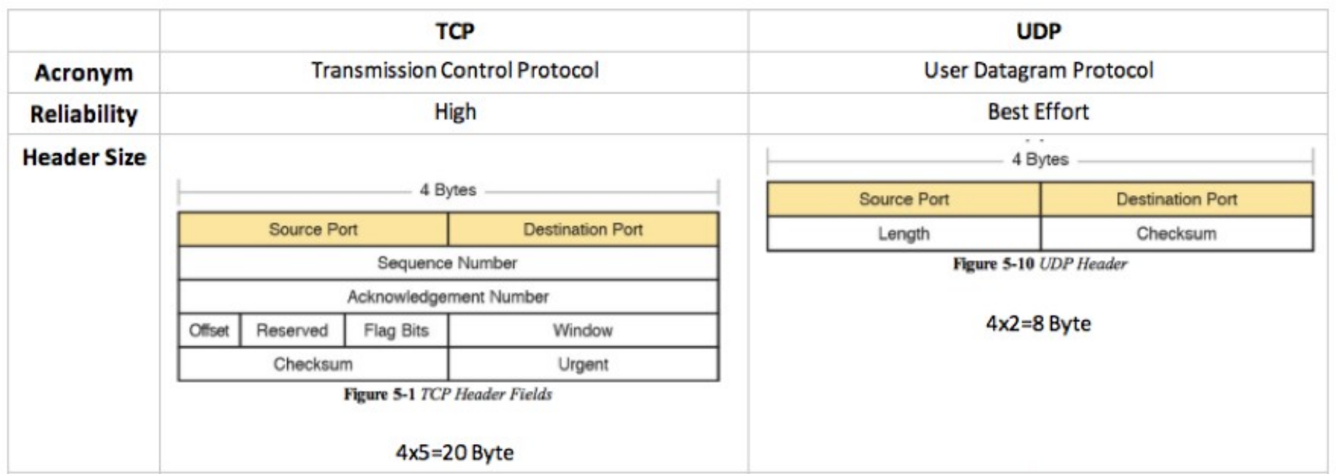
TRANSPORT
TCP vs UDP
• UDP: connectionless, 8-byte header, no retransmission or ordering.
• TCP: connection-oriented, reliable, ordered, flow-controlled.
• Choose the analysis by the transport: UDP problems show up at the application.
Header and feature comparison
Wireshark Network Analysis Masterclass (C1123) · C1123
© 2026 Tertiary Infotech Academy Pte Ltd
227

Slide 229
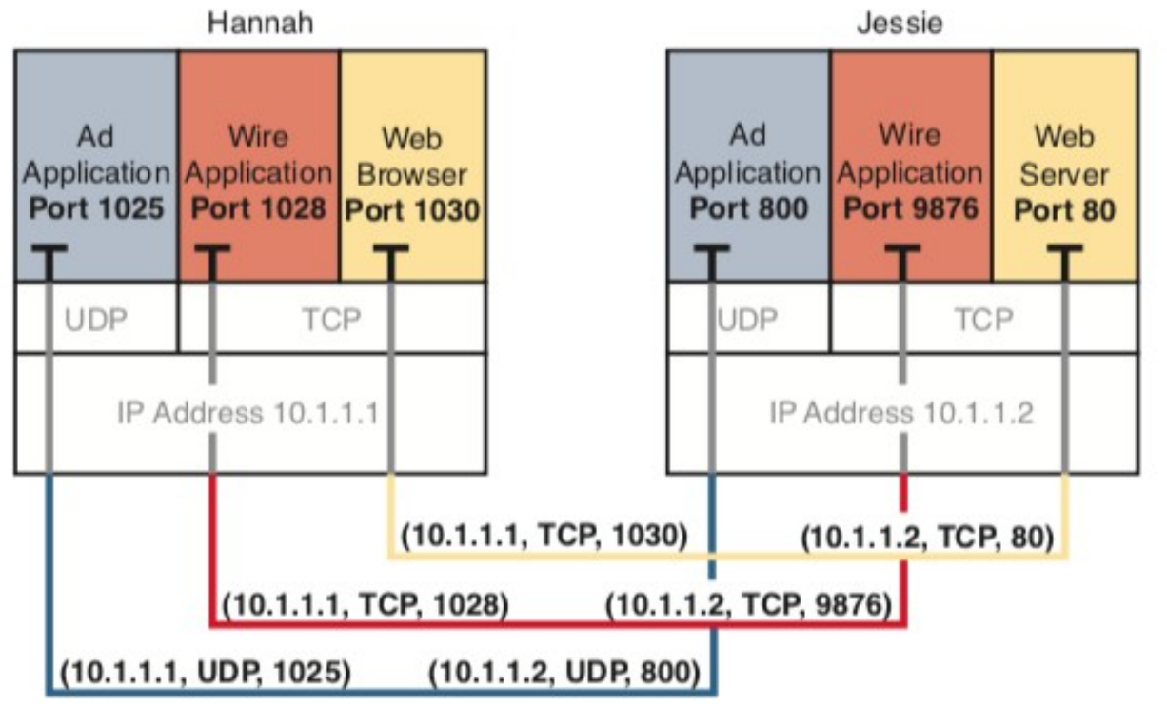
SOCKETS
Ports and Sockets
• A socket is IP address + port.
• A conversation is the pair of sockets — the 5-tuple with the protocol.
• Ephemeral client ports change per connection.
Socket pairs identify each conversation
Wireshark Network Analysis Masterclass (C1123) · C1123
© 2026 Tertiary Infotech Academy Pte Ltd
228

Slide 230
TECHNIQUES
Analysing UDP
Follow > UDP Stream reassembles a datagram conversation.
A UDP request answered by ICMP port unreachable = closed port.
1
2
Missing responses need application-level timing to interpret.
Decode As lets you dissect traffic on non-standard ports.
3
4
Wireshark Network Analysis Masterclass (C1123) · C1123
© 2026 Tertiary Infotech Academy Pte Ltd
229

Slide 231
TOPIC 13 · HANDS-ON
Follow datagrams and service refusal
LAB 13
UDP has no transport handshake or retransmission; the application may provide reliability.
You'll build
Evidence CSV and packet findings
Tools: Wireshark, TShark, Python
Wireshark Network Analysis Masterclass (C1123) · C1123
© 2026 Tertiary Infotech Academy Pte Ltd
230

Slide 232

LAB 13 · EXPECTED EVIDENCE
Expected Evidence — Lab 13
Produced by TShark 4.6 from this lab's own synthetic capture with the lab filter(s) applied — your packet list should match.
Wireshark Network Analysis Masterclass (C1123) · C1123
© 2026 Tertiary Infotech Academy Pte Ltd
231

Slide 233
LAB 13
Follow datagrams and service refusal
STEP 1 OF 6
Prepare your lab workspace. Open this lab folder in a terminal. Windows uses py -3 in place of python3. Wireshark GUI alone is sufficient for the investigation; CLI scripts require TShark on PATH. Run the fixture verification first.
1
$ python3 scripts/verify.py
Wireshark Network Analysis Masterclass (C1123) · C1123
© 2026 Tertiary Infotech Academy Pte Ltd
232

Slide 234
LAB 13
Follow datagrams and service refusal
STEP 2 OF 6
Open data/branch-office.pcap. Apply udp.dstport == 9999. One frame is the original datagram and one is the UDP header quoted inside ICMP; inspect the outer protocol to distinguish them.
2
Wireshark Network Analysis Masterclass (C1123) · C1123
© 2026 Tertiary Infotech Academy Pte Ltd
233

Slide 235
LAB 13
Follow datagrams and service refusal
STEP 3 OF 6
Select the original datagram and use Analyze > Follow > UDP Stream. Confirm the payload LAB-UDP. Save a text view to outputs/udp-stream.txt.
3
Wireshark Network Analysis Masterclass (C1123) · C1123
© 2026 Tertiary Infotech Academy Pte Ltd
234

Slide 236
LAB 13
Follow datagrams and service refusal
STEP 4 OF 6
Apply udp.port == 4002 and decode RTP using Analyze > Decode As. Compare datagram framing with the earlier TCP stream.
4
Wireshark Network Analysis Masterclass (C1123) · C1123
© 2026 Tertiary Infotech Academy Pte Ltd
235

Slide 237
LAB 13
Follow datagrams and service refusal
STEP 5 OF 6
Record why no UDP transport ACK exists in the trace. Use the ICMP refusal to explain why an application can fail even though a datagram was transmitted.
5
Wireshark Network Analysis Masterclass (C1123) · C1123
© 2026 Tertiary Infotech Academy Pte Ltd
236

Slide 238
LAB 13
Follow datagrams and service refusal
STEP 6 OF 6
Export a reproducible packet table. Record the filter, frame numbers, measurement, explanation and limitation in outputs/findings.md.
6
$ python3 scripts/export_evidence.py
Wireshark Network Analysis Masterclass (C1123) · C1123
© 2026 Tertiary Infotech Academy Pte Ltd
237

Slide 239
LAB 13 · VERIFY
Follow datagrams and service refusal
✅ Test it
The supplied udp.dstport == 9999 expression matches 2 frame(s) in the specified capture. Run scripts/verify.py and compare the listed frame numbers. Keep your findings and exported table in outputs/. Explain the observed result rather than only copying a count.
Wireshark Network Analysis Masterclass (C1123) · C1123
© 2026 Tertiary Infotech Academy Pte Ltd
238

Slide 240
TOPIC RECAP
Recap — UDP Traffic Analysis
You can now: interpret DNS, ARP, IPv4, ICMP and UDP evidence.
UDP has no transport handshake or retransmission; the application may provide reliability.
1
2
A port number is a decoding hint; payload and context identify the application.
Following a UDP stream collects datagrams and does not invent missing data.
3
4
Wireshark Network Analysis Masterclass (C1123) · C1123
© 2026 Tertiary Infotech Academy Pte Ltd
239

Slide 241
Tea Break
15 minutes

Slide 242
14
TOPIC 14
TCP Protocol Analysis
Investigate retransmission and zero window
Wireshark Network Analysis Masterclass (C1123) · C1123
© 2026 Tertiary Infotech Academy Pte Ltd
241

Slide 243
KEY CONCEPTS
Key Concepts — TCP Protocol Analysis
Sequence numbers count bytes; ACK numbers indicate the next expected byte.
Retransmission and duplicate ACK labels are heuristics sensitive to capture placement and completeness.
1
2
Zero window indicates receive-side flow control; it is distinct from network congestion.
3
Wireshark Network Analysis Masterclass (C1123) · C1123
© 2026 Tertiary Infotech Academy Pte Ltd
242

Slide 244

TCP
The Three-Way Handshake
• SYN → SYN/ACK → ACK establishes the connection.
• Options are negotiated here: MSS, window scale, SACK permitted.
• The SYN → SYN/ACK gap is the initial RTT seen by the client.
Connection establishment
Wireshark Network Analysis Masterclass (C1123) · C1123
© 2026 Tertiary Infotech Academy Pte Ltd
243

Slide 245

TCP
Sequence Numbers and Error Recovery
• Sequence numbers count bytes sent; ACK = next byte expected.
• A gap triggers duplicate ACKs and retransmission.
• Wireshark shows relative sequence numbers by default.
Lost segment recovered after the receiver asks again
Wireshark Network Analysis Masterclass (C1123) · C1123
© 2026 Tertiary Infotech Academy Pte Ltd
244

Slide 246

FLOW CONTROL
TCP Windowing
• The receive window advertises buffer space available.
• Window scaling multiplies it for high-bandwidth paths.
• Window = 0 (Zero Window) stops the sender until a window update.
Flow control with window advertisements
Wireshark Network Analysis Masterclass (C1123) · C1123
© 2026 Tertiary Infotech Academy Pte Ltd
245

Slide 247

LOSS
Retransmissions
• Timeout retransmission (RTO): no ACK in time — backs off exponentially.
• Fast retransmission: three duplicate ACKs trigger an early resend.
• Spurious retransmissions repeat data that was already received.
Retransmission timers on a lossy path
Wireshark Network Analysis Masterclass (C1123) · C1123
© 2026 Tertiary Infotech Academy Pte Ltd
246

Slide 248
EXPERT INFORMATION
TCP Expert Flags
Retransmission
Data sent again
Duplicate ACK
Receiver still waiting for a gap
1
2
Previous segment not captured
Gap — loss or capture drop
Zero Window
Receiver buffer full
3
4
Window Full
Sender filled the advertised window
RST
Abrupt connection reset
5
6
Wireshark Network Analysis Masterclass (C1123) · C1123
© 2026 Tertiary Infotech Academy Pte Ltd
247

Slide 249

PREFERENCES
TCP Preferences
• Analyze TCP sequence numbers — enables tcp.analysis.* flags.
• Calculate conversation timestamps — adds tcp.time_delta.
• Relative sequence numbers make streams readable.
Edit | Preferences | Protocols | TCP
Wireshark Network Analysis Masterclass (C1123) · C1123
© 2026 Tertiary Infotech Academy Pte Ltd
248

Slide 250
TOPIC 14 · HANDS-ON
Investigate retransmission and zero window
LAB 14
Sequence numbers count bytes; ACK numbers indicate the next expected byte.
You'll build
Evidence CSV and packet findings
Tools: Wireshark, TShark, Python
Wireshark Network Analysis Masterclass (C1123) · C1123
© 2026 Tertiary Infotech Academy Pte Ltd
249

Slide 251

LAB 14 · EXPECTED EVIDENCE
Expected Evidence — Lab 14
Produced by TShark 4.6 from this lab's own synthetic capture with the lab filter(s) applied — your packet list should match.
Wireshark Network Analysis Masterclass (C1123) · C1123
© 2026 Tertiary Infotech Academy Pte Ltd
250

Slide 252
LAB 14
Investigate retransmission and zero window
STEP 1 OF 6
Prepare your lab workspace. Open this lab folder in a terminal. Windows uses py -3 in place of python3. Wireshark GUI alone is sufficient for the investigation; CLI scripts require TShark on PATH. Run the fixture verification first.
1
$ python3 scripts/verify.py
Wireshark Network Analysis Masterclass (C1123) · C1123
© 2026 Tertiary Infotech Academy Pte Ltd
251

Slide 253
LAB 14
Investigate retransmission and zero window
STEP 2 OF 6
Open data/branch-office.pcap. Apply tcp.stream == 3. Open Analyze > Expert Information and note the repeated server segment.
2
Wireshark Network Analysis Masterclass (C1123) · C1123
© 2026 Tertiary Infotech Academy Pte Ltd
252

Slide 254
LAB 14
Investigate retransmission and zero window
STEP 3 OF 6
Apply tcp.analysis.retransmission and expand TCP. Compare the same sequence range and payload in the earlier segment; the repeat occurs 1.000 second later.
3
Wireshark Network Analysis Masterclass (C1123) · C1123
© 2026 Tertiary Infotech Academy Pte Ltd
253

Slide 255
LAB 14
Investigate retransmission and zero window
STEP 4 OF 6
Apply tcp.window_size_value == 0. Confirm the client ACK advertises zero receive window in stream 3. Examine the SYN options: window scaling is negotiated, but zero remains zero.
4
Wireshark Network Analysis Masterclass (C1123) · C1123
© 2026 Tertiary Infotech Academy Pte Ltd
254

Slide 256
LAB 14
Investigate retransmission and zero window
STEP 5 OF 6
Apply tcp.flags.reset == 1. Identify the port 81 refusal. Complete assets/tcp-evidence.csv with stream, frame, flag/analysis, measured interval and a limitation. Discuss SACK, fast recovery and out-of-order evidence without claiming those events occur in this fixture.
5
Wireshark Network Analysis Masterclass (C1123) · C1123
© 2026 Tertiary Infotech Academy Pte Ltd
255

Slide 257
LAB 14
Investigate retransmission and zero window
STEP 6 OF 6
Export a reproducible packet table. Record the filter, frame numbers, measurement, explanation and limitation in outputs/findings.md.
6
$ python3 scripts/export_evidence.py
Wireshark Network Analysis Masterclass (C1123) · C1123
© 2026 Tertiary Infotech Academy Pte Ltd
256

Slide 258
LAB 14 · VERIFY
Investigate retransmission and zero window
✅ Test it
The supplied tcp.analysis.retransmission expression matches 1 frame(s) in the specified capture. Run scripts/verify.py and compare the listed frame numbers. Keep your findings and exported table in outputs/. Explain the observed result rather than only copying a count.
Wireshark Network Analysis Masterclass (C1123) · C1123
© 2026 Tertiary Infotech Academy Pte Ltd
257

Slide 259
TOPIC RECAP
Recap — TCP Protocol Analysis
You can now: diagnose TCP and application behaviour, including HTTP and authorised TLS inspection.
Sequence numbers count bytes; ACK numbers indicate the next expected byte.
1
2
Retransmission and duplicate ACK labels are heuristics sensitive to capture placement and completeness.
Zero window indicates receive-side flow control; it is distinct from network congestion.
3
4
Wireshark Network Analysis Masterclass (C1123) · C1123
© 2026 Tertiary Infotech Academy Pte Ltd
258

Slide 260
End of Day 3
See you tomorrow

Slide 261
D4
DAY 4
Graphs, applications and reporting
Recap of the previous day, then today's topics and labs
Wireshark Network Analysis Masterclass (C1123) · C1123
© 2026 Tertiary Infotech Academy Pte Ltd
260

Slide 262
15
TOPIC 15
Traffic Graphs
Graph bytes, RTT and recovery
Wireshark Network Analysis Masterclass (C1123) · C1123
© 2026 Tertiary Infotech Academy Pte Ltd
261

Slide 263
KEY CONCEPTS
Key Concepts — Traffic Graphs
An I/O graph bins observed events; units and interval determine what it means.
TCP time-sequence graphs show byte progress, stalls and repeated sequence ranges.
1
2
RTT samples, application response time and throughput answer different questions.
3
Wireshark Network Analysis Masterclass (C1123) · C1123
© 2026 Tertiary Infotech Academy Pte Ltd
262

Slide 264

GRAPHS
I/O Graphs
• Statistics > I/O Graphs plots packets, bytes or bits per interval.
• Add graphs with filters — e.g. total vs tcp.analysis.flags.
• Use log scale and moving averages to compare very different values.
Multiple graphs with different filters on one chart
Wireshark Network Analysis Masterclass (C1123) · C1123
© 2026 Tertiary Infotech Academy Pte Ltd
263

Slide 265

GRAPHS
Reading an I/O Graph
Drops in throughput that line up with TCP expert events point to the cause
Wireshark Network Analysis Masterclass (C1123) · C1123
© 2026 Tertiary Infotech Academy Pte Ltd
264

Slide 266

GRAPHS
Round Trip Time Graph
• Statistics > TCP Stream Graphs > Round Trip Time.
• Graphs are unidirectional — pick the data-sending direction.
• Spikes show where the path or receiver was slow to acknowledge.
RTT per acknowledged segment
Wireshark Network Analysis Masterclass (C1123) · C1123
© 2026 Tertiary Infotech Academy Pte Ltd
265

Slide 267

GRAPHS
Time/Sequence (Stevens) Graph
• Sequence number vs time — the slope is throughput.
• Flat steps reveal stalls such as zero window.
• Vertical repeats indicate retransmissions.
A flat region marks a zero-window stall
Wireshark Network Analysis Masterclass (C1123) · C1123
© 2026 Tertiary Infotech Academy Pte Ltd
266

Slide 268

GRAPHS
Window Scaling Graph
• Plots the receiver's advertised window alongside bytes in flight.
• When bytes in flight meet the window, the receiver is the bottleneck.
• A collapsing window points at the receiving application.
Stable window, instability and zero window
Wireshark Network Analysis Masterclass (C1123) · C1123
© 2026 Tertiary Infotech Academy Pte Ltd
267

Slide 269
TOPIC 15 · HANDS-ON
Graph bytes, RTT and recovery
LAB 15
An I/O graph bins observed events; units and interval determine what it means.
You'll build
Evidence CSV and packet findings
Tools: Wireshark, TShark, Python
Wireshark Network Analysis Masterclass (C1123) · C1123
© 2026 Tertiary Infotech Academy Pte Ltd
268

Slide 270

LAB 15 · EXPECTED EVIDENCE
Expected Evidence — Lab 15
Produced by TShark 4.6 from this lab's own synthetic capture with the lab filter(s) applied — your packet list should match.
Wireshark Network Analysis Masterclass (C1123) · C1123
© 2026 Tertiary Infotech Academy Pte Ltd
269

Slide 271
LAB 15
Graph bytes, RTT and recovery
STEP 1 OF 6
Prepare your lab workspace. Open this lab folder in a terminal. Windows uses py -3 in place of python3. Wireshark GUI alone is sufficient for the investigation; CLI scripts require TShark on PATH. Run the fixture verification first.
1
$ python3 scripts/verify.py
Wireshark Network Analysis Masterclass (C1123) · C1123
© 2026 Tertiary Infotech Academy Pte Ltd
270

Slide 272
LAB 15
Graph bytes, RTT and recovery
STEP 2 OF 6
Open data/branch-office.pcap. Select a packet in TCP stream 3. Open Statistics > TCP Stream Graphs > Time Sequence (Stevens) and inspect the repeated server sequence.
2
Wireshark Network Analysis Masterclass (C1123) · C1123
© 2026 Tertiary Infotech Academy Pte Ltd
271

Slide 273
LAB 15
Graph bytes, RTT and recovery
STEP 3 OF 6
Open Statistics > I/O Graphs. Add a retransmission graph with filter tcp.analysis.retransmission and a zero-window graph with filter tcp.analysis.zero_window. Use packets and a 1 second interval; record their event bins.
3
Wireshark Network Analysis Masterclass (C1123) · C1123
© 2026 Tertiary Infotech Academy Pte Ltd
272

Slide 274
LAB 15
Graph bytes, RTT and recovery
STEP 4 OF 6
Open TCP Stream Graphs > Round Trip Time. Compare eligible ACK samples with the 30 ms SYN-to-SYN/ACK interval and the 40 ms complete handshake/initial_rtt on the final ACK. Explain why no ACK sample exists for an unacknowledged segment before its repeat.
4
Wireshark Network Analysis Masterclass (C1123) · C1123
© 2026 Tertiary Infotech Academy Pte Ltd
273

Slide 275
LAB 15
Graph bytes, RTT and recovery
STEP 5 OF 6
Run the report script to export timestamps and byte lengths, then write outputs/graph-notes.md with interval, unit, stream, visible pattern and limitation. Do not use SUM(tcp.seq) as throughput.
5
Wireshark Network Analysis Masterclass (C1123) · C1123
© 2026 Tertiary Infotech Academy Pte Ltd
274

Slide 276
LAB 15
Graph bytes, RTT and recovery
STEP 6 OF 6
Export a reproducible packet table. Record the filter, frame numbers, measurement, explanation and limitation in outputs/findings.md.
6
$ python3 scripts/export_evidence.py
Wireshark Network Analysis Masterclass (C1123) · C1123
© 2026 Tertiary Infotech Academy Pte Ltd
275

Slide 277
LAB 15 · VERIFY
Graph bytes, RTT and recovery
✅ Test it
The supplied tcp.analysis.retransmission || tcp.analysis.zero_window expression matches 2 frame(s) in the specified capture. Run scripts/verify.py and compare the listed frame numbers. Keep your findings and exported table in outputs/. Explain the observed result rather than only copying a count.
Wireshark Network Analysis Masterclass (C1123) · C1123
© 2026 Tertiary Infotech Academy Pte Ltd
276

Slide 278
TOPIC RECAP
Recap — Traffic Graphs
You can now: diagnose TCP and application behaviour, including HTTP and authorised TLS inspection.
An I/O graph bins observed events; units and interval determine what it means.
1
2
TCP time-sequence graphs show byte progress, stalls and repeated sequence ranges.
RTT samples, application response time and throughput answer different questions.
3
4
Wireshark Network Analysis Masterclass (C1123) · C1123
© 2026 Tertiary Infotech Academy Pte Ltd
277

Slide 279
Tea Break
15 minutes

Slide 280
16
TOPIC 16
HTTP and HTTP/2 Analysis
Inspect HTTP outcomes and HTTP/2 frames
Wireshark Network Analysis Masterclass (C1123) · C1123
© 2026 Tertiary Infotech Academy Pte Ltd
279

Slide 281
KEY CONCEPTS
Key Concepts — HTTP and HTTP/2 Analysis
HTTP response codes describe application outcomes after transport delivery.
A response time contains more than network latency; pair the correct request and response.
1
2
HTTP/2 multiplexes frames; encrypted HTTP/2 needs authorised TLS secrets to inspect payload.
3
Wireshark Network Analysis Masterclass (C1123) · C1123
© 2026 Tertiary Infotech Academy Pte Ltd
280

Slide 282
HTTP
HTTP Response Codes
2xx / 3xx
4xx client
5xx server
• 200 OK
• 301/302 redirect
• 304 not modified
• 400 bad request
• 403 forbidden
• 404 not found
• 500 internal error
• 502 bad gateway
• 503 unavailable
Wireshark Network Analysis Masterclass (C1123) · C1123
© 2026 Tertiary Infotech Academy Pte Ltd
281

Slide 283

REASSEMBLY
Follow the Stream
• Right-click > Follow > TCP Stream (or HTTP Stream) reassembles the conversation.
• Client data in red, server data in blue.
• The filter changes to tcp.stream == N — clear it to return.
Follow Stream reassembles the transferred data
Wireshark Network Analysis Masterclass (C1123) · C1123
© 2026 Tertiary Infotech Academy Pte Ltd
282

Slide 284

EXPORT
Export HTTP Objects
• File > Export Objects > HTTP lists every transferred object.
• Save files for inspection — handle unknown content safely.
• http.time measures each response time.
File | Export Objects | HTTP
Wireshark Network Analysis Masterclass (C1123) · C1123
© 2026 Tertiary Infotech Academy Pte Ltd
283

Slide 285
PROTOCOLS
HTTP/1.1 vs HTTP/2
HTTP/1.1
HTTP/2
• Text headers, one request at a time per connection
• Readable directly in the packet list
• http.request.method, http.response.code
• Binary frames multiplexed into streams
• Usually inside TLS (ALPN h2)
• http2.type, http2.streamid; Decode As for clear-text test ports
Wireshark Network Analysis Masterclass (C1123) · C1123
© 2026 Tertiary Infotech Academy Pte Ltd
284

Slide 286
TOPIC 16 · HANDS-ON
Inspect HTTP outcomes and HTTP/2 frames
LAB 16
HTTP response codes describe application outcomes after transport delivery.
You'll build
Evidence CSV and packet findings
Tools: Wireshark, TShark, Python
Wireshark Network Analysis Masterclass (C1123) · C1123
© 2026 Tertiary Infotech Academy Pte Ltd
285

Slide 287

LAB 16 · EXPECTED EVIDENCE
Expected Evidence — Lab 16
Produced by TShark 4.6 from this lab's own synthetic capture with the lab filter(s) applied — your packet list should match.
Wireshark Network Analysis Masterclass (C1123) · C1123
© 2026 Tertiary Infotech Academy Pte Ltd
286

Slide 288
LAB 16
Inspect HTTP outcomes and HTTP/2 frames
STEP 1 OF 6
Prepare your lab workspace. Open this lab folder in a terminal. Windows uses py -3 in place of python3. Wireshark GUI alone is sufficient for the investigation; CLI scripts require TShark on PATH. Run the fixture verification first.
1
$ python3 scripts/verify.py
Wireshark Network Analysis Masterclass (C1123) · C1123
© 2026 Tertiary Infotech Academy Pte Ltd
287

Slide 289
LAB 16
Inspect HTTP outcomes and HTTP/2 frames
STEP 2 OF 6
Open data/branch-office.pcap. Apply http.request || http.response. Pair /health, /slow, /missing and /fault with their response codes.
2
Wireshark Network Analysis Masterclass (C1123) · C1123
© 2026 Tertiary Infotech Academy Pte Ltd
288

Slide 290
LAB 16
Inspect HTTP outcomes and HTTP/2 frames
STEP 3 OF 6
Select the /health response and Follow > TCP Stream. Confirm LAB-OK. Use File > Export Objects > HTTP to save the health text object into outputs/objects/.
3
Wireshark Network Analysis Masterclass (C1123) · C1123
© 2026 Tertiary Infotech Academy Pte Ltd
289

Slide 291
LAB 16
Inspect HTTP outcomes and HTTP/2 frames
STEP 4 OF 6
Apply tcp.port == 8080. Use Analyze > Decode As and set TCP port 8080 to HTTP2. Inspect the connection preface and SETTINGS frame (type 4). This fixture uses cleartext prior knowledge, not HTTPS.
4
Wireshark Network Analysis Masterclass (C1123) · C1123
© 2026 Tertiary Infotech Academy Pte Ltd
290

Slide 292
LAB 16
Inspect HTTP outcomes and HTTP/2 frames
STEP 5 OF 6
Run scripts/verify.py, then save outputs/http-summary.csv with URI, status, response interval and proposed next step. Discuss how multiple HTTP/2 stream IDs share one TCP connection.
5
Wireshark Network Analysis Masterclass (C1123) · C1123
© 2026 Tertiary Infotech Academy Pte Ltd
291

Slide 293
LAB 16
Inspect HTTP outcomes and HTTP/2 frames
STEP 6 OF 6
Export a reproducible packet table. Record the filter, frame numbers, measurement, explanation and limitation in outputs/findings.md.
6
$ python3 scripts/export_evidence.py
Wireshark Network Analysis Masterclass (C1123) · C1123
© 2026 Tertiary Infotech Academy Pte Ltd
292

Slide 294
LAB 16 · VERIFY
Inspect HTTP outcomes and HTTP/2 frames
✅ Test it
The supplied http.response.code >= 400 expression matches 2 frame(s) in the specified capture. Run scripts/verify.py and compare the listed frame numbers. Keep your findings and exported table in outputs/. Explain the observed result rather than only copying a count.
Wireshark Network Analysis Masterclass (C1123) · C1123
© 2026 Tertiary Infotech Academy Pte Ltd
293

Slide 295
TOPIC RECAP
Recap — HTTP and HTTP/2 Analysis
You can now: diagnose TCP and application behaviour, including HTTP and authorised TLS inspection.
HTTP response codes describe application outcomes after transport delivery.
1
2
A response time contains more than network latency; pair the correct request and response.
HTTP/2 multiplexes frames; encrypted HTTP/2 needs authorised TLS secrets to inspect payload.
3
4
Wireshark Network Analysis Masterclass (C1123) · C1123
© 2026 Tertiary Infotech Academy Pte Ltd
294

Slide 296
Lunch Break
1 hour

Slide 297
17
TOPIC 17
TLS-Encrypted Traffic Analysis
Compare encrypted and decrypted views
Wireshark Network Analysis Masterclass (C1123) · C1123
© 2026 Tertiary Infotech Academy Pte Ltd
296

Slide 298
KEY CONCEPTS
Key Concepts — TLS-Encrypted Traffic Analysis
Without session secrets, encrypted application records do not disclose HTTP payload.
A controlled key log enables authorised inspection of this synthetic TLS exchange.
1
2
A server RSA private key alone cannot decrypt modern ECDHE or TLS 1.3 sessions.
3
Wireshark Network Analysis Masterclass (C1123) · C1123
© 2026 Tertiary Infotech Academy Pte Ltd
297

Slide 299
TLS
TLS Handshake Evidence
Client Hello
Server Hello
Application Data
• SNI = requested server name
• Offered versions and ciphers
• tls.handshake.type == 1
• Chosen version and cipher
• Certificate (TLS 1.2)
• tls.handshake.type == 2
• Encrypted records
• Sizes and timing still visible
• tls.record.content_type == 23
Wireshark Network Analysis Masterclass (C1123) · C1123
© 2026 Tertiary Infotech Academy Pte Ltd
298

Slide 300
DECRYPTION
Decrypting TLS — Authorised Only
Works
Does not work
• Key log file from the client (SSLKEYLOGFILE)
• Preferences > Protocols > TLS > (Pre)-Master-Secret log filename
• Works for TLS 1.2 and TLS 1.3
• RSA private key with (EC)DHE or TLS 1.3 sessions
• Captures without the matching session secrets
• Anything you are not authorised to inspect
Wireshark Network Analysis Masterclass (C1123) · C1123
© 2026 Tertiary Infotech Academy Pte Ltd
299

Slide 301
LAB 17 PREVIEW
Encrypted vs Decrypted View
1
2
3
4
5
▶
▶
▶
▶
Open the TLS capture — only handshake and Application Data
Note what metadata is still visible
Load the lab key log file
HTTP requests and responses appear
Remove the key log before the next lab
Wireshark Network Analysis Masterclass (C1123) · C1123
© 2026 Tertiary Infotech Academy Pte Ltd
300

Slide 302
TOPIC 17 · HANDS-ON
Compare encrypted and decrypted views
LAB 17
Without session secrets, encrypted application records do not disclose HTTP payload.
You'll build
Evidence CSV and packet findings
Tools: Wireshark, TShark, Python
Wireshark Network Analysis Masterclass (C1123) · C1123
© 2026 Tertiary Infotech Academy Pte Ltd
301

Slide 303

LAB 17 · EXPECTED EVIDENCE
Expected Evidence — Lab 17
Produced by TShark 4.6 from this lab's own synthetic capture with the lab filter(s) applied — your packet list should match.
Wireshark Network Analysis Masterclass (C1123) · C1123
© 2026 Tertiary Infotech Academy Pte Ltd
302

Slide 304
LAB 17
Compare encrypted and decrypted views
STEP 1 OF 6
Prepare your lab workspace. Open this lab folder in a terminal. Windows uses py -3 in place of python3. Wireshark GUI alone is sufficient for the investigation; CLI scripts require TShark on PATH. Run the fixture verification first.
1
$ python3 scripts/verify.py
Wireshark Network Analysis Masterclass (C1123) · C1123
© 2026 Tertiary Infotech Academy Pte Ltd
303

Slide 305
LAB 17
Compare encrypted and decrypted views
STEP 2 OF 6
Open data/tls-session.pcap. In Preferences > Protocols > TLS, clear the (Pre)-Master-Secret log filename, then apply tls. Identify ClientHello and encrypted application records.
2
Wireshark Network Analysis Masterclass (C1123) · C1123
© 2026 Tertiary Infotech Academy Pte Ltd
304

Slide 306
LAB 17
Compare encrypted and decrypted views
STEP 3 OF 6
Expand ClientHello > Extensions > server_name. Record portal.example.test. The lab uses a real TLS 1.2 MemoryBIO exchange, a temporary self-signed certificate and offline synthetic TCP wrapping.
3
Wireshark Network Analysis Masterclass (C1123) · C1123
© 2026 Tertiary Infotech Academy Pte Ltd
305

Slide 307
LAB 17
Compare encrypted and decrypted views
STEP 4 OF 6
Set Preferences > Protocols > TLS > (Pre)-Master-Secret log filename to the absolute path of data/lab-tls.keys. Reload the capture. Apply http and confirm GET /health and 200 OK containing LAB-OK.
4
Wireshark Network Analysis Masterclass (C1123) · C1123
© 2026 Tertiary Infotech Academy Pte Ltd
306

Slide 308
LAB 17
Compare encrypted and decrypted views
STEP 5 OF 6
Run scripts/verify.py for both encrypted/decrypted checks. Clear the key-log preference when finished. The supplied secrets are synthetic lab session material; never copy production session secrets into a public repository.
5
Wireshark Network Analysis Masterclass (C1123) · C1123
© 2026 Tertiary Infotech Academy Pte Ltd
307

Slide 309
LAB 17
Compare encrypted and decrypted views
STEP 6 OF 6
Export a reproducible packet table. Record the filter, frame numbers, measurement, explanation and limitation in outputs/findings.md.
6
$ python3 scripts/export_evidence.py
Wireshark Network Analysis Masterclass (C1123) · C1123
© 2026 Tertiary Infotech Academy Pte Ltd
308

Slide 310
LAB 17 · VERIFY
Compare encrypted and decrypted views
✅ Test it
The supplied tls.handshake.type == 1 expression matches 1 frame(s) in the specified capture. Run scripts/verify.py and compare the listed frame numbers. Keep your findings and exported table in outputs/. Explain the observed result rather than only copying a count.
Wireshark Network Analysis Masterclass (C1123) · C1123
© 2026 Tertiary Infotech Academy Pte Ltd
309

Slide 311
TOPIC RECAP
Recap — TLS-Encrypted Traffic Analysis
You can now: diagnose TCP and application behaviour, including HTTP and authorised TLS inspection.
Without session secrets, encrypted application records do not disclose HTTP payload.
1
2
A controlled key log enables authorised inspection of this synthetic TLS exchange.
A server RSA private key alone cannot decrypt modern ECDHE or TLS 1.3 sessions.
3
4
Wireshark Network Analysis Masterclass (C1123) · C1123
© 2026 Tertiary Infotech Academy Pte Ltd
310

Slide 312
Tea Break
15 minutes

Slide 313
18
TOPIC 18
Ten Troubleshooting Steps and Reporting
Produce an evidence-led incident report
Wireshark Network Analysis Masterclass (C1123) · C1123
© 2026 Tertiary Infotech Academy Pte Ltd
312

Slide 314
KEY CONCEPTS
Key Concepts — Ten Troubleshooting Steps and Reporting
Begin with scope and a baseline, then focus with endpoints, filters, time and graphs.
Separate observed facts from hypotheses and specify what new evidence would test them.
1
2
A useful report states affected flow, measurement, impact, recommended action and uncertainty.
3
Wireshark Network Analysis Masterclass (C1123) · C1123
© 2026 Tertiary Infotech Academy Pte Ltd
313

Slide 315
METHOD
Ten-Step Troubleshooting Method
1
2
3
4
5
▶
▶
▶
▶
Baseline "normal" traffic
Check conversations and endpoints
Apply focused filters and colour
Measure time and TCP evidence
Graph, follow streams and report
Wireshark Network Analysis Masterclass (C1123) · C1123
© 2026 Tertiary Infotech Academy Pte Ltd
314

Slide 316

EVIDENCE
Export and Preserve Evidence
• File > Export Specified Packets saves only the relevant frames.
• Export Packet Dissections produces text/CSV for reports.
• Keep the original capture unchanged and record its hash.
File | Export Packet Dissections
Wireshark Network Analysis Masterclass (C1123) · C1123
© 2026 Tertiary Infotech Academy Pte Ltd
315

Slide 317
REPORTING
Writing the Incident Report
Observed facts
Interpretation
Next actions
• Frame numbers
• Filters used
• Measured times and counts
• What the evidence suggests
• Alternative explanations
• Confidence level
• Further captures needed
• Owner and system to check
• Limitations of this trace
Wireshark Network Analysis Masterclass (C1123) · C1123
© 2026 Tertiary Infotech Academy Pte Ltd
316

Slide 318
TOPIC 18 · HANDS-ON
Produce an evidence-led incident report
LAB 18
Begin with scope and a baseline, then focus with endpoints, filters, time and graphs.
You'll build
Evidence CSV and packet findings
Tools: Wireshark, TShark, Python
Wireshark Network Analysis Masterclass (C1123) · C1123
© 2026 Tertiary Infotech Academy Pte Ltd
317

Slide 319

LAB 18 · EXPECTED EVIDENCE
Expected Evidence — Lab 18
Produced by TShark 4.6 from this lab's own synthetic capture with the lab filter(s) applied — your packet list should match.
Wireshark Network Analysis Masterclass (C1123) · C1123
© 2026 Tertiary Infotech Academy Pte Ltd
318

Slide 320
LAB 18
Produce an evidence-led incident report
STEP 1 OF 6
Prepare your lab workspace. Open this lab folder in a terminal. Windows uses py -3 in place of python3. Wireshark GUI alone is sufficient for the investigation; CLI scripts require TShark on PATH. Run the fixture verification first.
1
$ python3 scripts/verify.py
Wireshark Network Analysis Masterclass (C1123) · C1123
© 2026 Tertiary Infotech Academy Pte Ltd
319

Slide 321
LAB 18
Produce an evidence-led incident report
STEP 2 OF 6
Open data/branch-office.pcap. Read assets/incident-ticket.md. Use Statistics > Conversations, filters and Expert Information to identify the failing /fault request.
2
Wireshark Network Analysis Masterclass (C1123) · C1123
© 2026 Tertiary Infotech Academy Pte Ltd
320

Slide 322
LAB 18
Produce an evidence-led incident report
STEP 3 OF 6
Record evidence for the DNS delay, slow HTTP response, retransmission, zero window and port 81 refusal. Use exact frames and elapsed times rather than a claim that every symptom has one cause.
3
Wireshark Network Analysis Masterclass (C1123) · C1123
© 2026 Tertiary Infotech Academy Pte Ltd
321

Slide 323
LAB 18
Produce an evidence-led incident report
STEP 4 OF 6
Complete assets/report-template.md and save as outputs/incident-report.md. Include scope, timeline, observations, competing explanations, next capture placement and a client-safe recommendation.
4
Wireshark Network Analysis Masterclass (C1123) · C1123
© 2026 Tertiary Infotech Academy Pte Ltd
322

Slide 324
LAB 18
Produce an evidence-led incident report
STEP 5 OF 6
Use assets/ten-step-checklist.md to review the report. Re-run scripts/verify.py. Exchange reports with another learner and check that every conclusion can be traced to a packet or is explicitly a hypothesis.
5
Wireshark Network Analysis Masterclass (C1123) · C1123
© 2026 Tertiary Infotech Academy Pte Ltd
323

Slide 325
LAB 18
Produce an evidence-led incident report
STEP 6 OF 6
Export a reproducible packet table. Record the filter, frame numbers, measurement, explanation and limitation in outputs/findings.md.
6
$ python3 scripts/export_evidence.py
Wireshark Network Analysis Masterclass (C1123) · C1123
© 2026 Tertiary Infotech Academy Pte Ltd
324

Slide 326
LAB 18 · VERIFY
Produce an evidence-led incident report
✅ Test it
The supplied http.response.code == 500 expression matches 1 frame(s) in the specified capture. Run scripts/verify.py and compare the listed frame numbers. Keep your findings and exported table in outputs/. Explain the observed result rather than only copying a count.
Wireshark Network Analysis Masterclass (C1123) · C1123
© 2026 Tertiary Infotech Academy Pte Ltd
325

Slide 327
TOPIC RECAP
Recap — Ten Troubleshooting Steps and Reporting
You can now: report observed facts, hypotheses and next actions with defensible evidence.
Begin with scope and a baseline, then focus with endpoints, filters, time and graphs.
1
2
Separate observed facts from hypotheses and specify what new evidence would test them.
A useful report states affected flow, measurement, impact, recommended action and uncertainty.
3
4
Wireshark Network Analysis Masterclass (C1123) · C1123
© 2026 Tertiary Infotech Academy Pte Ltd
326

Slide 328
WRAP-UP
Course Summary & Next Steps
Wireshark Network Analysis Masterclass (C1123) · C1123
© 2026 Tertiary Infotech Academy Pte Ltd
327

Slide 329
LEARNING OUTCOMES
What You Achieved
Capture & profile
Plan scoped captures and configure a reproducible analyst profile.
Navigate & time
Navigate, filter, summarize and time network exchanges.
1
2
Core protocols
Interpret DNS, ARP, IPv4, ICMP and UDP evidence.
TCP & applications
Diagnose TCP and application behaviour, including HTTP and authorised TLS inspection.
3
4
Evidence reporting
Report observed facts, hypotheses and next actions with defensible evidence.
5
Wireshark Network Analysis Masterclass (C1123) · C1123
© 2026 Tertiary Infotech Academy Pte Ltd
328

Slide 330
NEXT STEPS
Continue Your Learning
All course material stays on the LMS at https://lms-tms.tertiaryinfotech.com.
The 18 labs and their captures are in the course GitHub repository — re-run them any time.
1
2
Apply the ten-step troubleshooting checklist to an authorised capture at work.
Explore networking and cyber-security courses at www.tertiarycourses.com.sg.
3
4
Wireshark Network Analysis Masterclass (C1123) · C1123
© 2026 Tertiary Infotech Academy Pte Ltd
329

Slide 331
WRAP-UP
Keep Practising After the Course
Re-run the labs on your own machine — repetition is what makes the skills stick.
Apply the techniques to a real process or project in your own organisation.
1
2
Your course material stays available at https://lms-tms.tertiaryinfotech.com/.
Explore the follow-on courses at www.tertiarycourses.com.sg.
3
4
Wireshark Network Analysis Masterclass (C1123) · C1123
© 2026 Tertiary Infotech Academy Pte Ltd
330

Slide 332
THANK YOU FOR ATTENDING
Thank You!
Keep the evidence, explain the uncertainty — and keep practising with the 18 labs on your own machine.
Wireshark Network Analysis Masterclass (C1123) · C1123
© 2026 Tertiary Infotech Academy Pte Ltd
331

